Slide 1
Population synthesis of exoplanets
Sergei popov

Slide 2
Population synthesis in astrophysics
A population synthesis is a method of a direct modeling of relatively large populations
of weakly interacting objects with non-trivial evolution.
As a rule, the evolution of the objects is followed from their birth up to the present moment.
Evolutionary and Empirical
Evolutionary PS. The evolution is followed from some early stage.
Typically, an artificial population is formed (especially, in Monte Carlo simulations)
Empirical PS.
It is used, for example, to study integral properties (speсtra) of unresolved populations.
A library of spectra is used to predict integral properties.
astro-ph/0411792

Slide 3
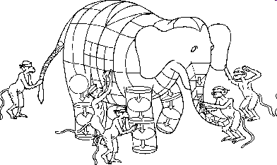
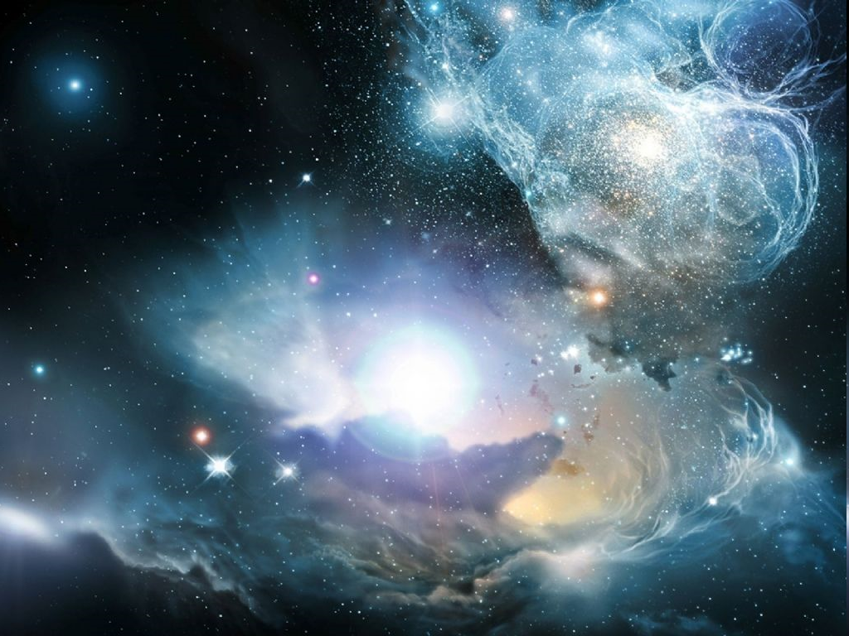
Ingredients: - initial condition - evolutionary laws
Modeling observations
«Artificial observed universe»
«Artificial universe»

Slide 4
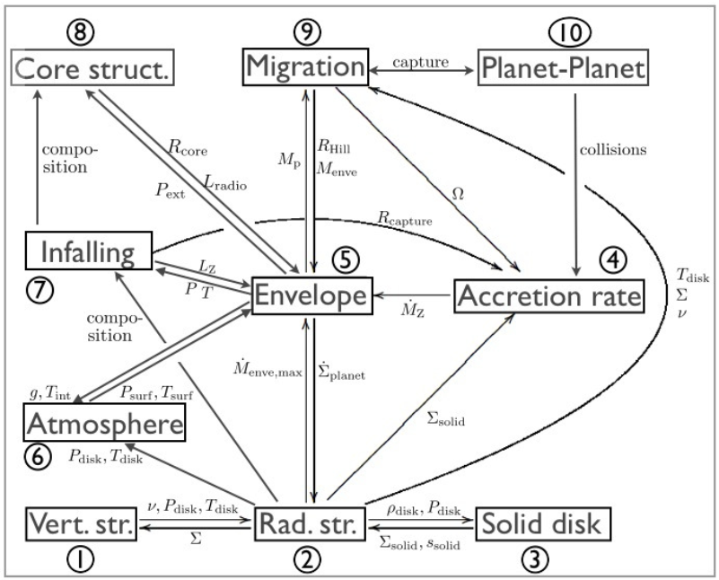
1402.7086

Slide 5
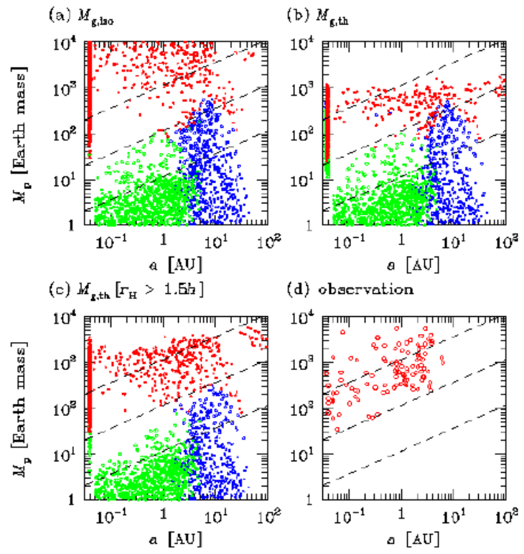
The first PS model for exoplanets
Authors modeled formation and migration (I&II) of exoplanets in order to reproduce so-called “desert” in mass-semi-major axis distribution (masses 10-100 Earth mass, and a<3 AU).
Main ingredients:
Disk model;
Accretion model;
Migration model.
The rate of type I migration was significantly reduced to avoid rapid planet displacement.
Red- giants; green – rocky; blue – ice.
Ida, Lin astro-ph/0312144

Slide 6
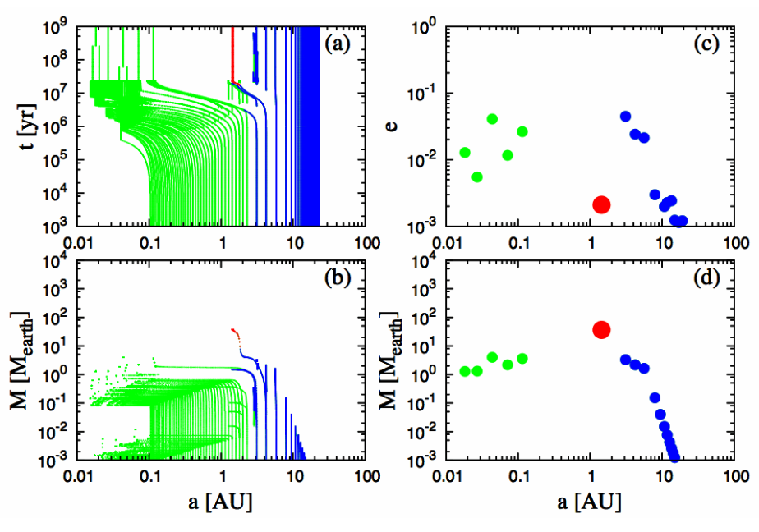
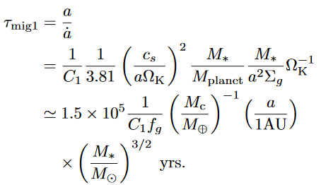
Individual tracks
Green - rock Red - gas Blue - ice
C₁ = 0.1; f_{d,0}=2
Ida, Lin 2013

Slide 7
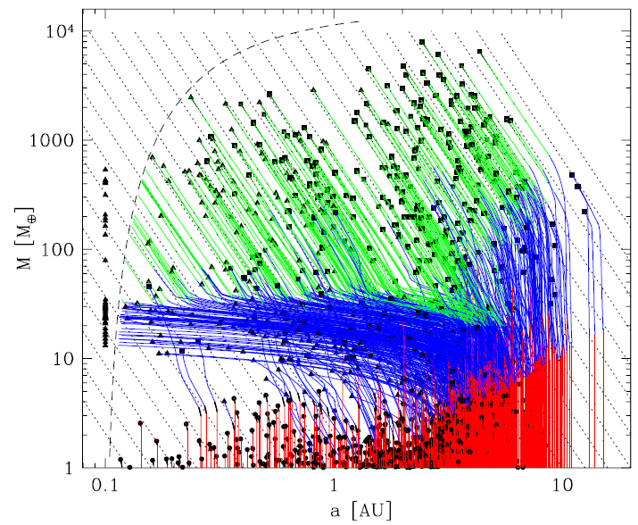
Mordasini et al. models
Mordanisi et al. published a series of papers (0904.2524, 0904.2542, 1101.0513, 1201.1036) on population synthesis of exoplanets, using an approach generally similar to the one by Ida, Lin. Then this studies were continued in
1206.6103, 1206.3303, 1708.00868. A review is given in 1402.7086. An important step is too include planet-planet interactions. A separate subject is to follow long-term evolution.
0904.2524

Slide 8
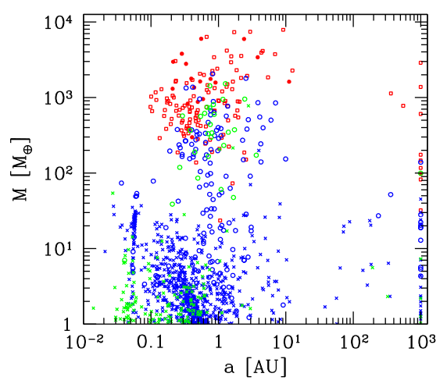
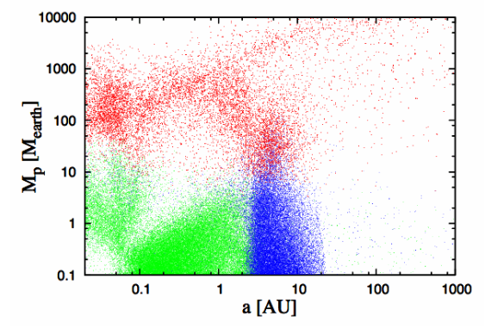
Mass – semi-major axis distribution
Alibert et al. (2013)
Ida, Lin (2013)
1402.7086

Slide 9
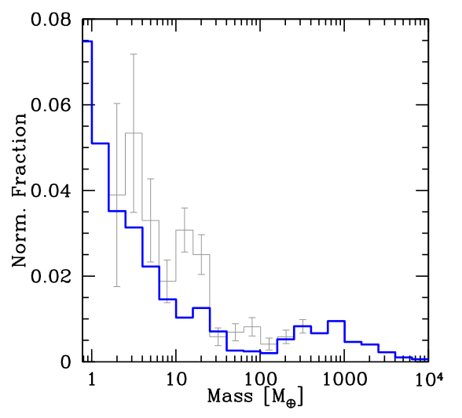
Mass distribution
It is still not absolutely clear, if the so-called “planetary desert” exist or not.
1402.7086

Slide 10
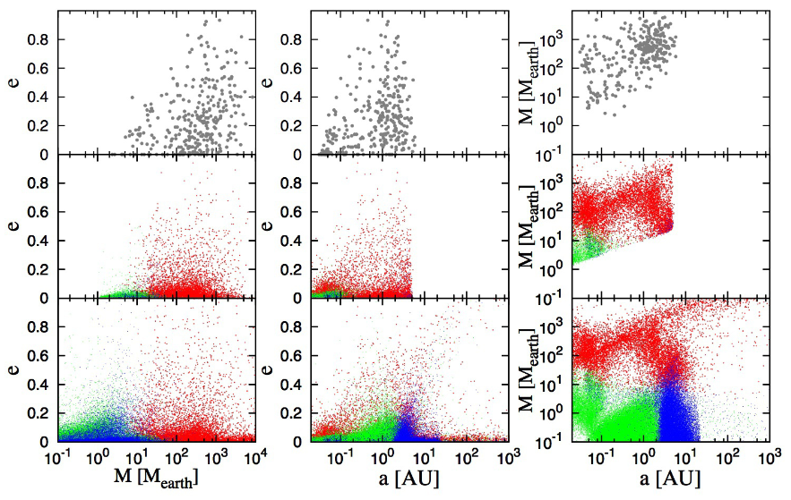
Comparison with observations
Observations
Calculations for observable planets (P_{orb}<10 yrs; v>1 m/s)
Calculations
Ida, Lin (2013)
1402.7086

Slide 11
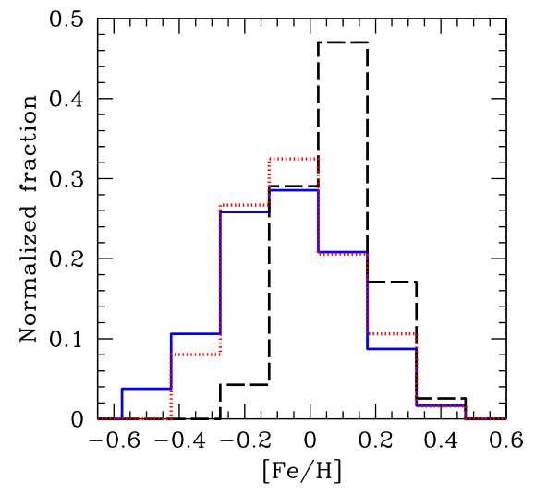
Metallicity effect
Solid line – all stars. Dashed line – stars with at least one giant planet. Dotted line – stars with at least low-mass planet.
1402.7086

Slide 12
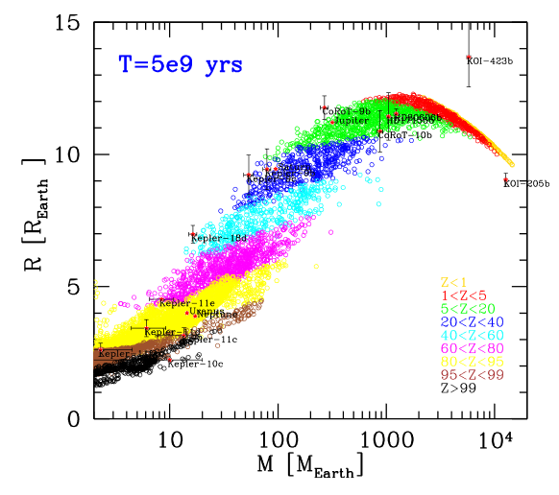
Composition
Formation and evolution model allows to estimate the bulk composition of planets.
1402.7086

Slide 13
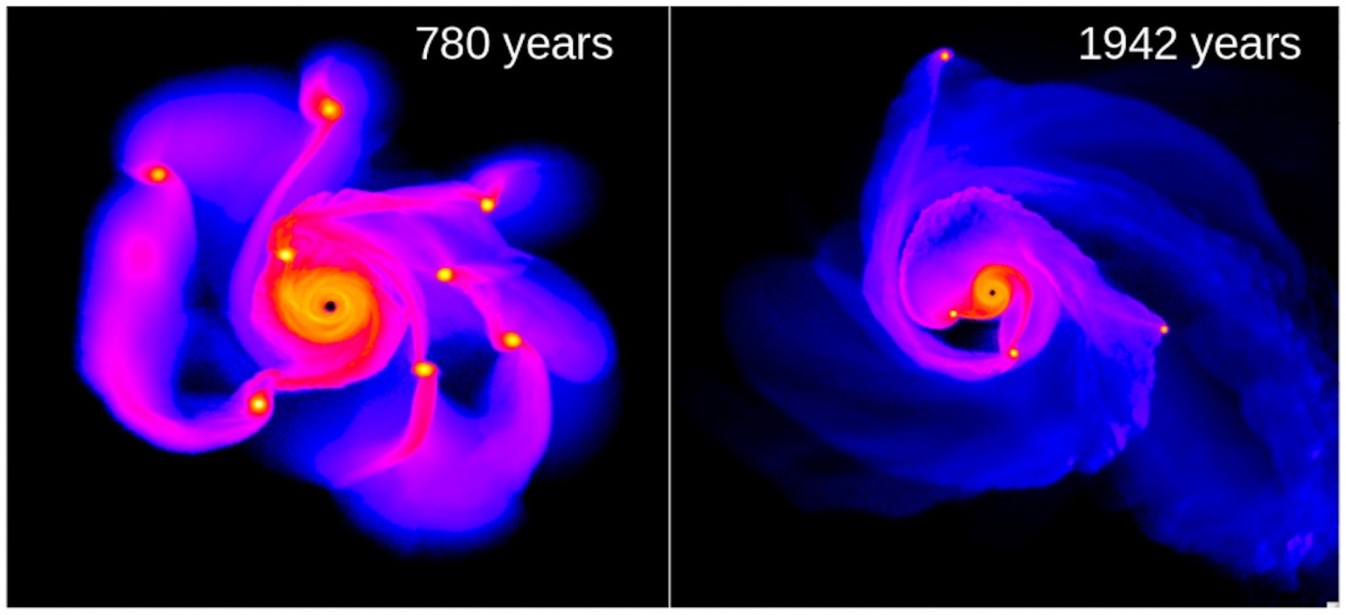
Another way to form planets
Gravitational instability in the outer parts of the disc. Allows to form massive planets out to few tens AU. Might also work for brown dwarfs and very light stars.
Lucio Mayer & T. Quinn
Some new results in 1711.05948

Slide 14
Tidal downsizing
Hypothesis by Nayakshin (2010). It is possible to make solid planets at low orbits
Fragment mass just after fragmentation
Hill radius becomes smaller as a planet migrates towards the star.
Evolution of a fragment is a disc can result in appearance of a low-mass planet closer to the star, or in appearance if a belt of particles.
1304.4978

Slide 15
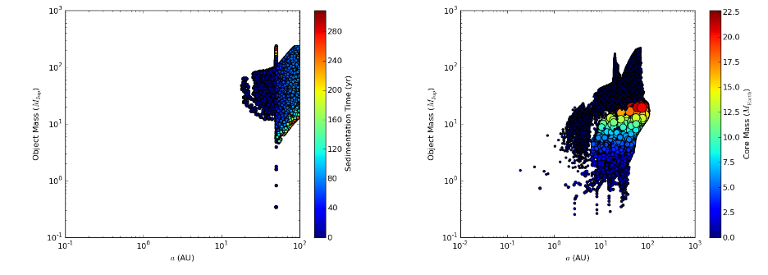
Initial and final semi-major axis distribution
1304.4978

Slide 16
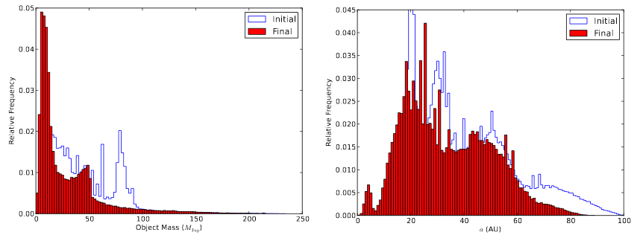
Mass and semi-major axis distribution
1304.4978

Slide 17
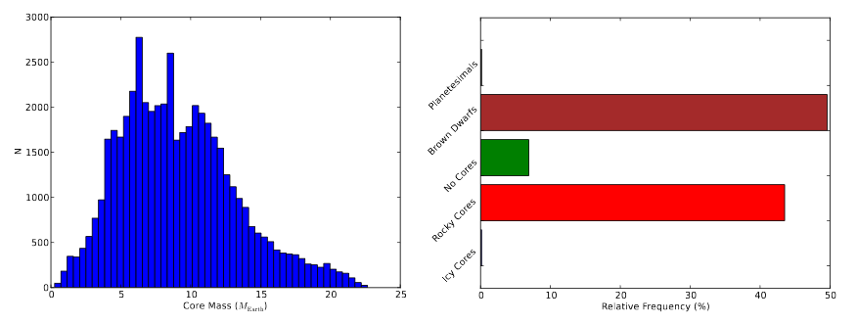
Mass distribution and planet types
Many brown dwarfs (and even low-mass stars for some parameters) can be produced via this channel.
1711.01133

Slide 18
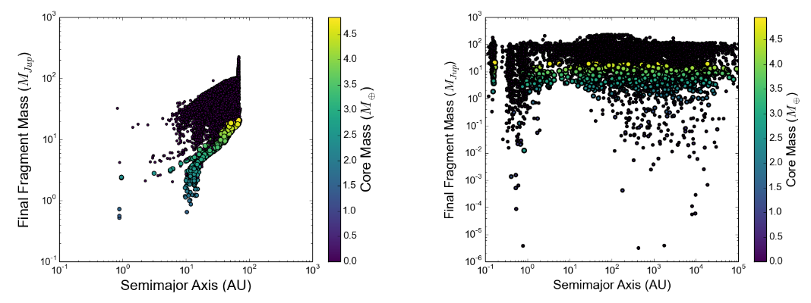
Role of fragment-fragment interaction
Interaction off
Interaction on
1711.01133

Slide 19
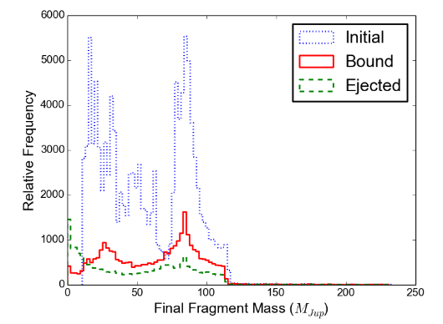
Ejection
Many fragments are ejected. So, this mechanism of planet formation can be an important contributor to the population of free-floating planets and brown dwarfs.
1711.01133

Slide 20
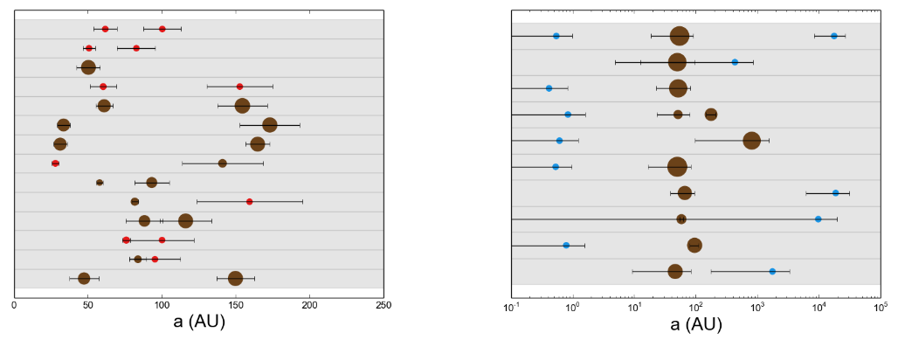
System architecture
Typical systems
Non-typical systems
1711.01133

Slide 21
Literature
1402.7086 Planet Population Synthesis W. Benz et al.

