Slide 1
Solar system
Sergei popov

Slide 2
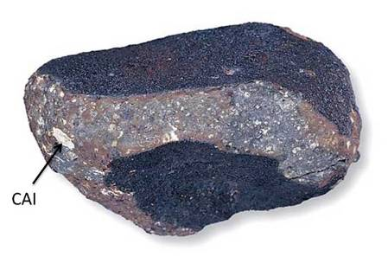
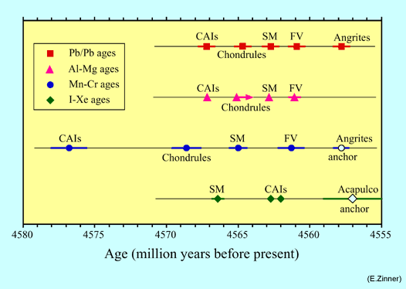
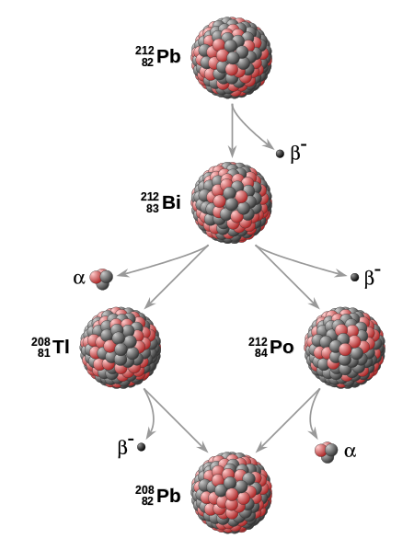
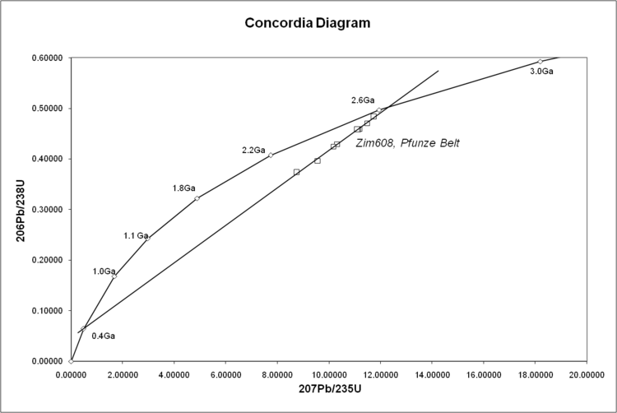
Solar system age
http://www.nhm.ac.uk
The age is determined due to meteorite studies. Chondrites are made of non-processed matter. ²⁶Al half life-time 730 kyrs (-> ²⁶Mg). CAI – Ca-Al Inclusions. Al-Mg – short lived, U-Pb – long lived.
4.567 Gyrs
http://www.psrd.hawaii.edu/Sept02/Al26clock.html
wikipedia.org
No uranium in CAIs -> Pb-Pb.
See details at http://www.tulane.edu/~sanelson/eens211/radiometric_dating.htm
Notes:
http://www.nhm.ac.uk/natureplus/community/research/earth_sciences_news/meteorites/blog/2014/06/04/welcome-to-the-meteorite-group-blog
http://www.psrd.hawaii.edu/Sept02/isotopicAges.html

Slide 3
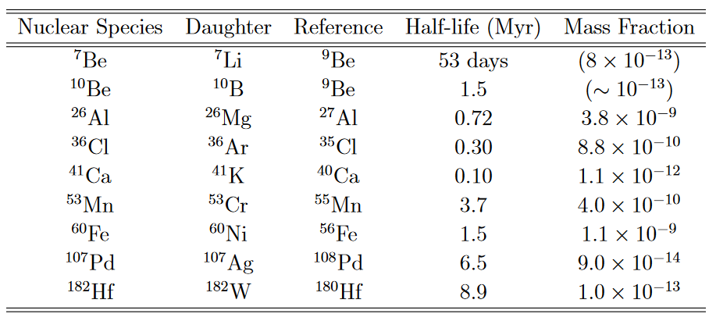
Short lived isotops
1001.5444

Slide 4
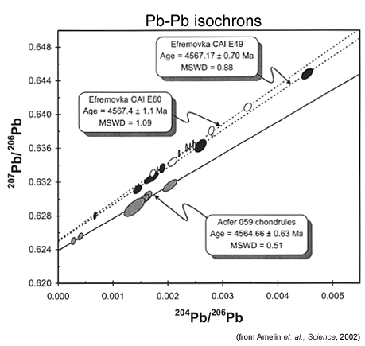
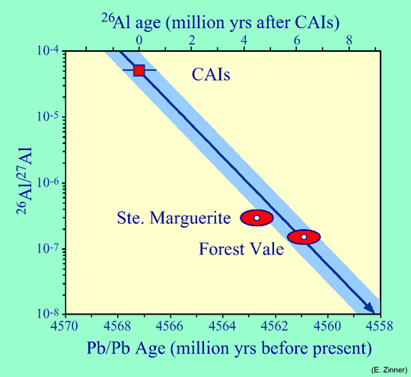
Two approaches complete each other
http://www.psrd.hawaii.edu/Sept02/isotopicAges.html
http://www.psrd.hawaii.edu/Sept02/Al26clock.html

Slide 5
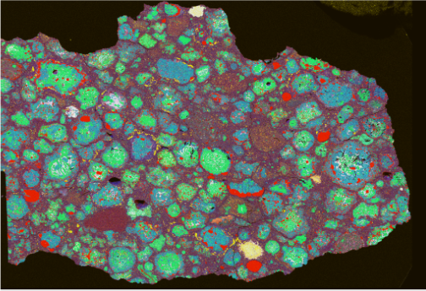
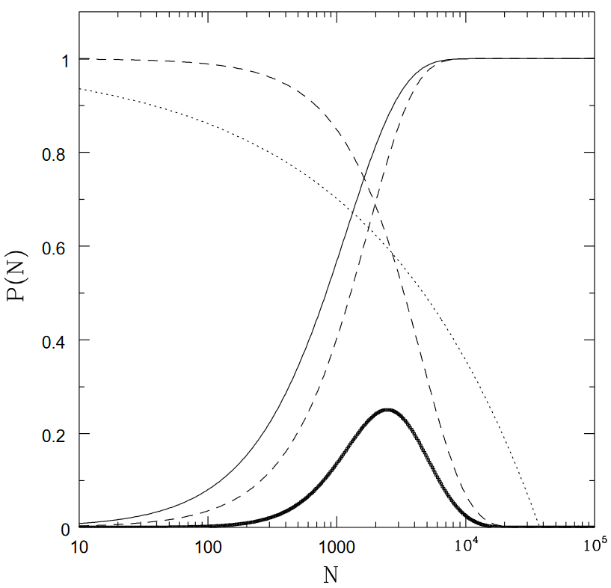
Origin of ²⁶Al and other short lived elements
Near-by supernova or an AGB/WR star.
Cluster cannot be too rich, otherwise EUV and FUV emission of massive stars can significantly influence protoplanetary disc within 30 AU due to photoevaporation.
1501.03101
1001.5444
aluminum (white), magnesium (green),
silicion (blue), calcium (yellow), iron (red)
Number of stars in the Sun cluster

Slide 6
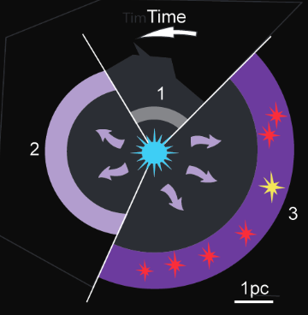
Supernova vs. evolved star
SN overproduce ⁶⁰Fe in comparison with ²⁶Al.
Thus, the exact origin is not known, yet. It seems that Fe-60 has been formed due to a SN (on larger time scale), and Al-26 – appeared from wind of a near-by evolved star.
Distribution of small-body’s orbits also put constraints on properties of the solar cluster (see 1001.5444).
Model of Al-26 “logistic” by a stellar wind. A dense envelope is continuously enriched in Al-26, and the Sun is formed from this material.
1501.03101

Slide 7
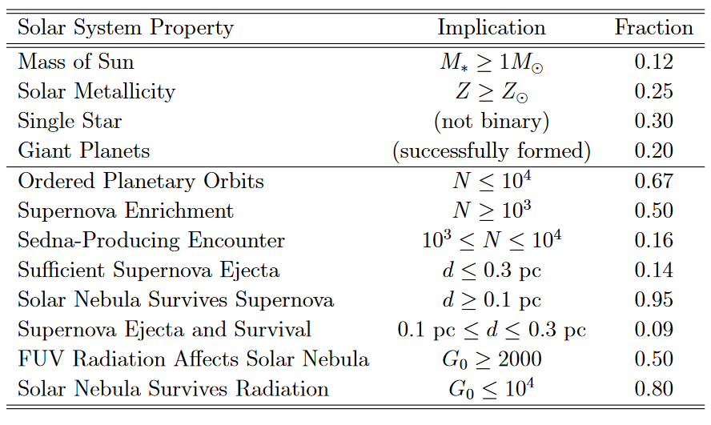
Constraints on the solar cluster
1001.5444

Slide 8
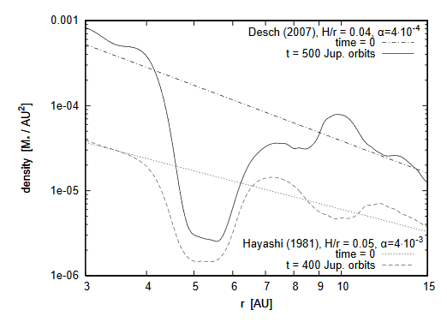
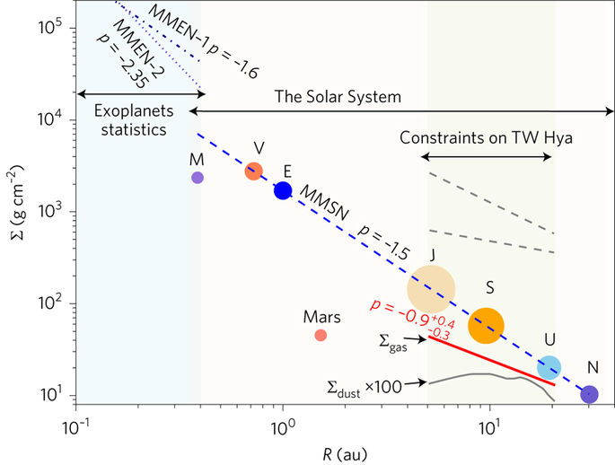
Minimum mass solar nebula
0903.5077
Zhang et al. (2017). Nature Astronomy v. 1

Slide 9
Different variants of the MMSN
Desch 2007 Planets at initial positions in the NICE model
Hayashi 1981 Normalized by the estimate of Jupiter formation 1.55<r<7 AU (mass of solids = 15 Earth masses)
Important: nebula parameters might allow proper regime of planetary migration (0903.5077).
In the classical MMSN mass of the disc is ~0.01 solar mass between 2 and 30 AU.

Slide 10
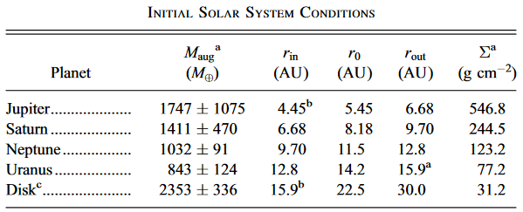
New MMSN model
Based on the Nice model
Gas/solid = 67 (i.e. solids = 1.5%)
Initial positions: Jupiter – 5.45 AU; Saturn – 8.18 AU; Neptune – 11.5 AU; Uranus – 14.2 AU
Uranus and Neptune change places during migration!
Desch 2007

Slide 11
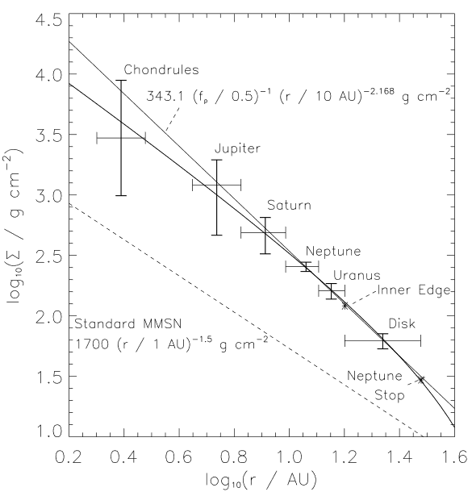
Surface density
Steep profile is achieved thanks to photoevaporation of the outer parts of the disc due to influence of a massive star.
Mass partly flows out to compensate losses.
Desch 2007

Slide 12
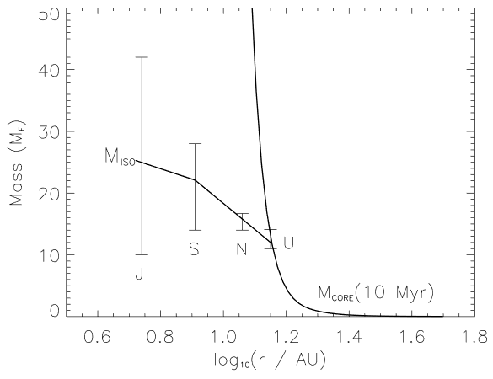
Comparison with the isolation mass
Vertical lines – total amount of solids in each planet.
Planets collect almost all available solids in their feeding zones.
Desch 2007

Slide 13
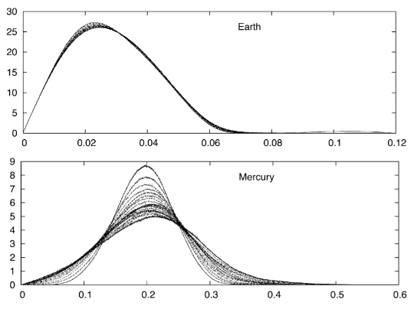
Long term evolution of the Solar system
On each plot the 19 curves represent intervals of 250 Myr. Each curve is based on 1001 solutions
with very close initial conditions.
The variation of these curves reflects
the chaotic diffusion of the solutions (Laskar 2008).
1501.03101

Slide 14
Three papers in Nature in 2005:
Planet migration
Late heavy bombardment
Jupiter Troyans
Four giant planets + a disc of planetesimals with the mass 35 M_{Earth}

Slide 15
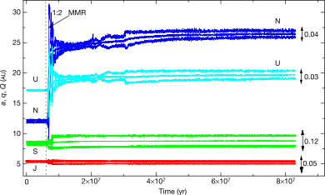
Planet migration in the Nice model
wikipedia.org
Tsiganis et al. 2005

Slide 16
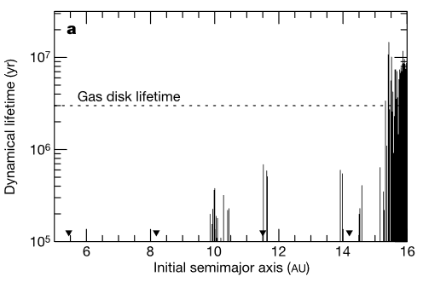
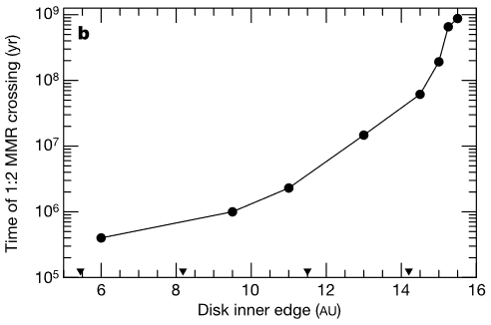
Late heavy bombardment
Position of the disc of planetesimals determines the rate of planet migration. Thus, the time of 1:2 resonance crossing depends on the position of the disc’s edge.
Jupiter-Saturn 1:2 resonance is crossed at ~600-900 Myrs after formation.
While the gas disk is still existing not all particles can survive long enough. Thus, the inner edge of the planetesimals disc appears at ~15-16 AU.
Gomes et al. 2005

Slide 17
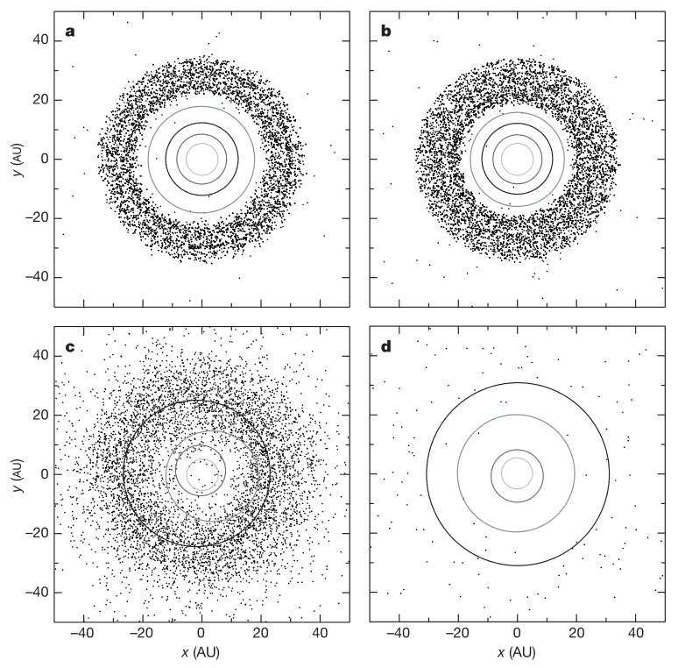
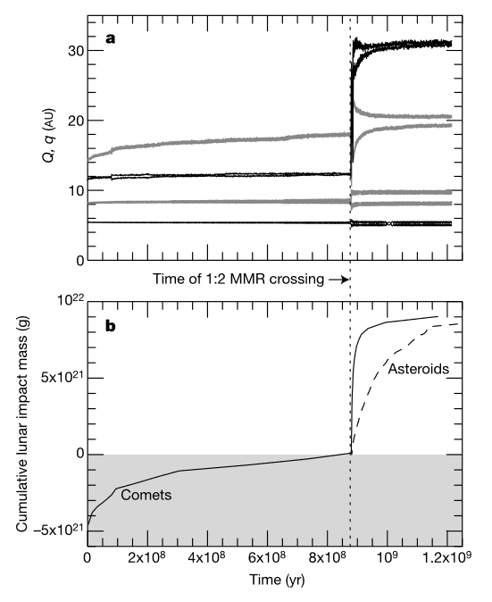
Dynamics
100 Myr
879 Myr
LHB lasted for ~100 Myr
882 Myr
+200Myr
Mass accreted by the Moon
Gomes et al. 2005

Slide 18
Nice model

Slide 19
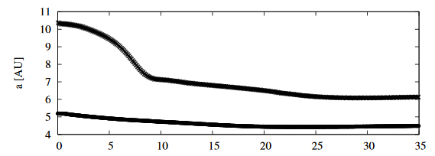
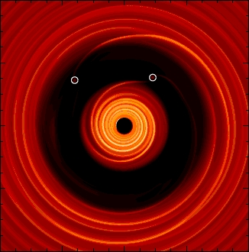
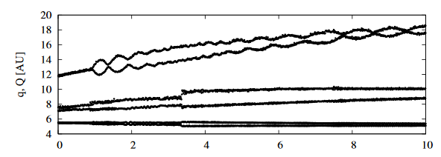
Solar system secular evolution: resonance crossing
planetplanet.net
After evolution in the gas disc Jupiter and Saturn are in 3:2 resonance. At this stage eccentricities and inclinations are low. It is non-trivial to explain present-day eccentricities and inclinations. It was proposed that it can be potentially solved if these planets crossed resonances and interacted with ice giants on eccentric orbits. But strong interaction of an ice giant with Saturn is a better option.
Morbidelli et al. 2009

Slide 20
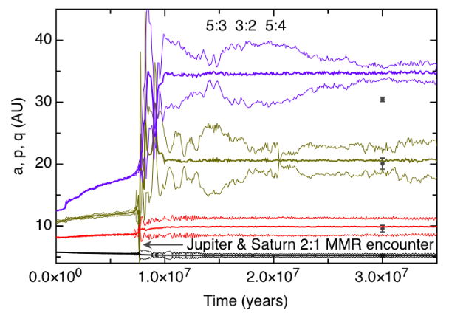
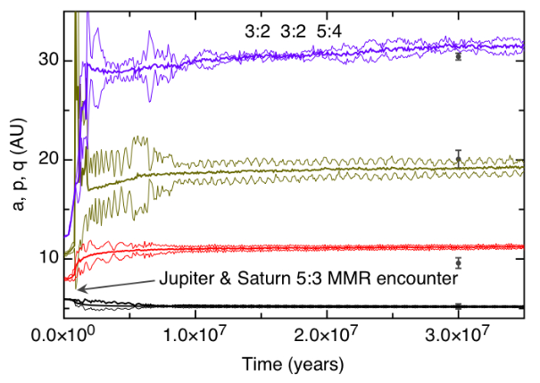
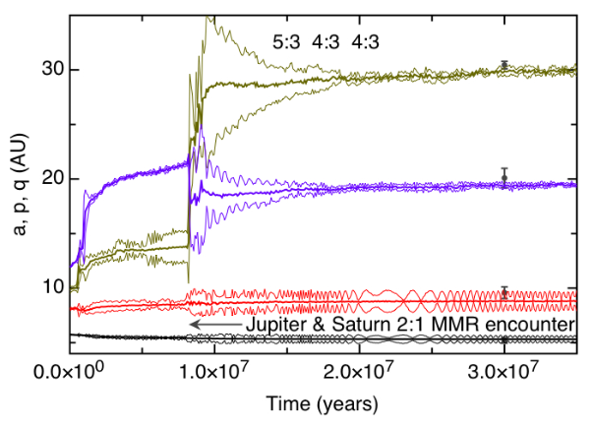
Further studies
Role of initial resonance conditions
for all four giants.
1004.5414

Slide 21
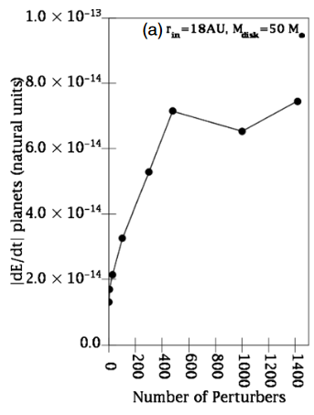
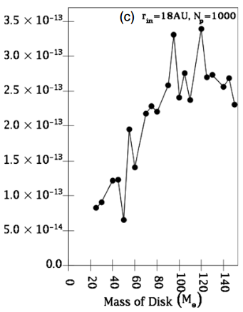
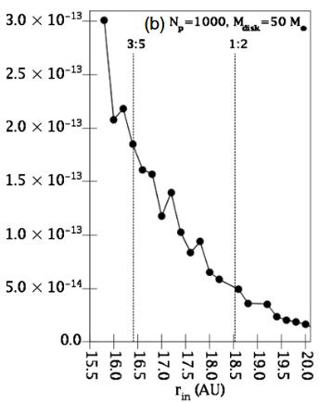
Modifications of the original Nice model
Initial (resonant) conditions in the Nice II model. + a disc which is now more massive 50 M_{Earth}
Interaction between disc particles (stirring) and eccentricity of planets are important factors for planets-disc interaction. Internal ice giant might have larger eccentricity after evolution in the gas disc. Interaction of this planet with the disc of planetesimals can result in the instability in the planetary system.
Levison et al. 2011

Slide 22
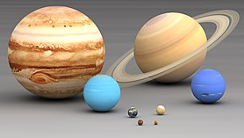
More problems (and solutions?)
Problem: light Mars
Solution: cut planetesimal disc at 1 AU
How: Jupiter!

Slide 23
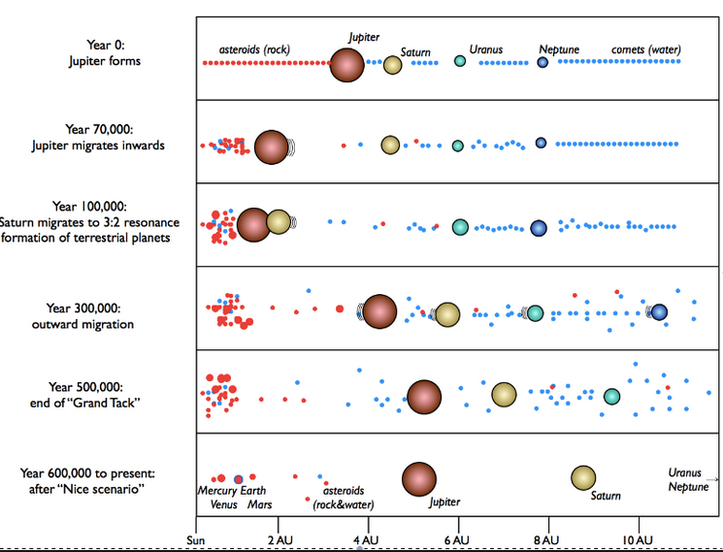
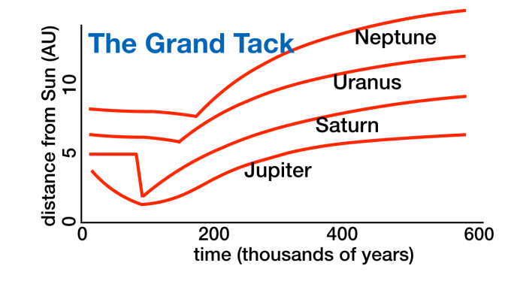
Grand tack
Proposed by Walsh et al. (2011). Explains why Mars is small (truncation of planetesimals disc).
See a simple introduction at https://planetplanet.net/2013/08/02/the-grand-tack/

Slide 24
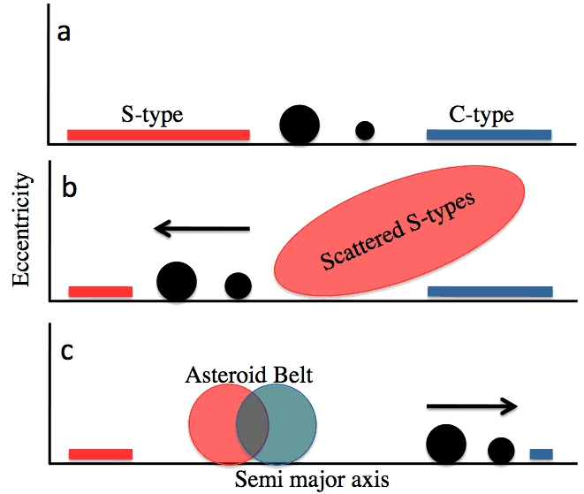
Grand tack
https://planetplanet.net/2013/08/02/the-grand-tack
see movies at http://perso.astrophy.u-bordeaux.fr/SRaymond/movies_grandtack.html

Slide 25
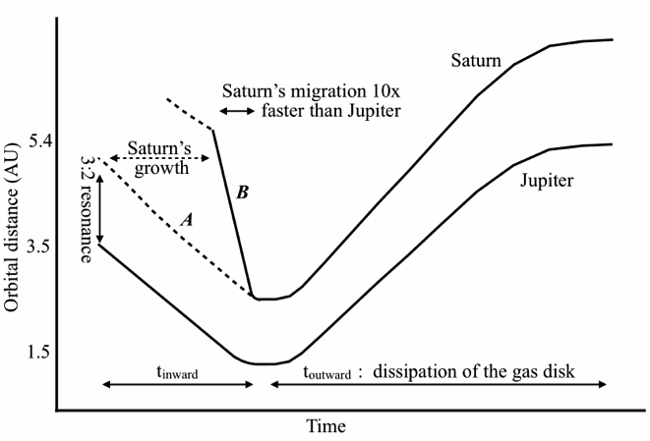
Phases of the Grand tack
Jupiter and Saturn form earlier than terrestrial planets. Thus, it is possible to influence the disc of planetesimals (emryos for terrestrial planets) with giants, if they can migrate closer to the region of solid planets formation.
http://perso.astrophy.u-bordeaux.fr/SRaymond/movies_grandtack.html

Slide 26
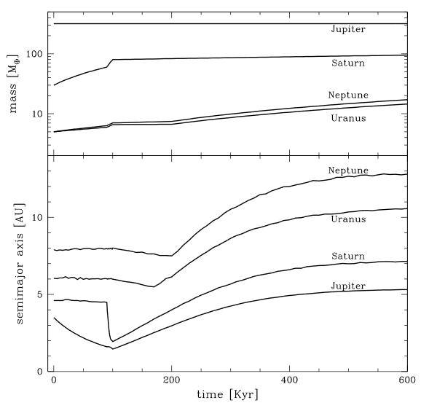
Grand Tack
Results of calculation of planet migration from the original paper Walsh et al. (2011)
1201.5177

Slide 27
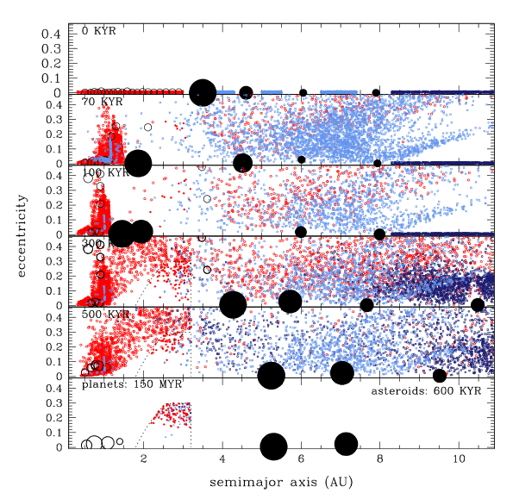
Small bodies
Evolution of orbits of small bodies from the original paper Walsh et al. (2011).
1201.5177

Slide 28
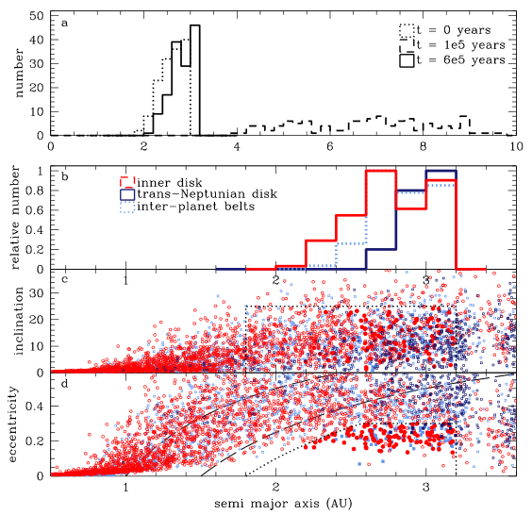
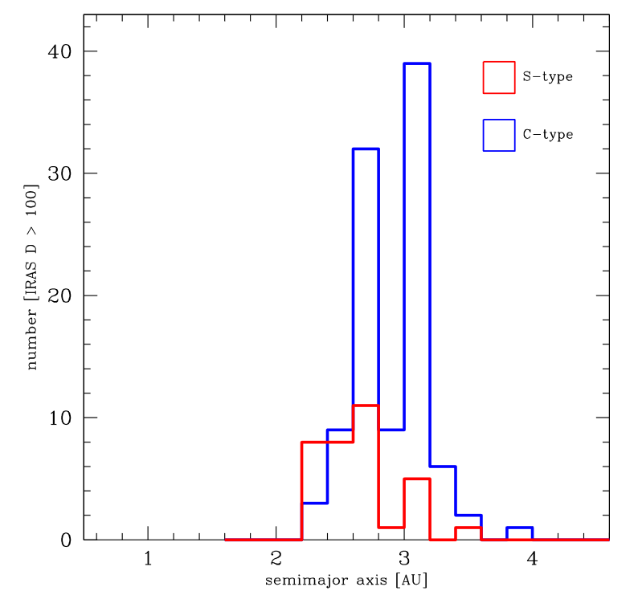
Asteroids
Observed
1201.5177

Slide 29
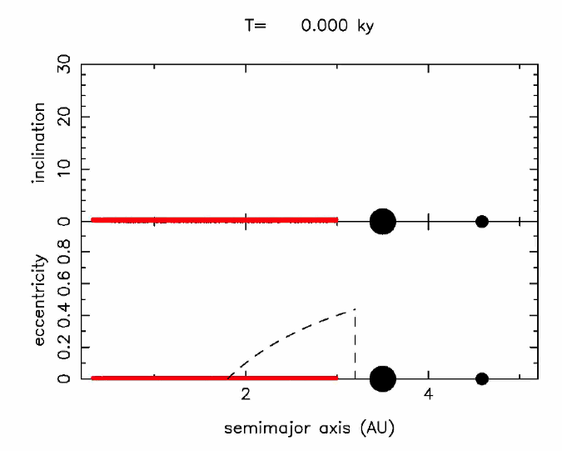
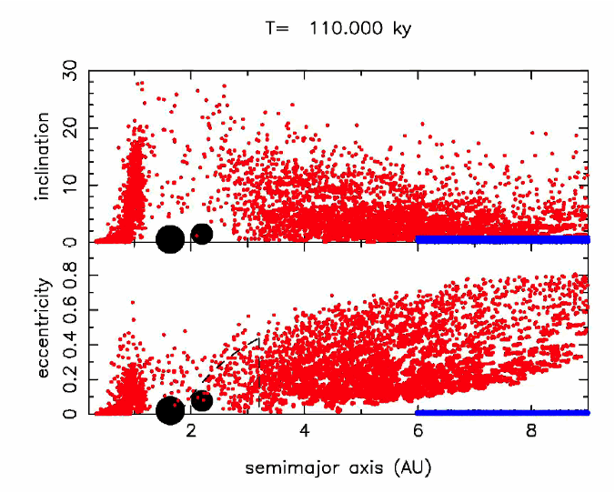
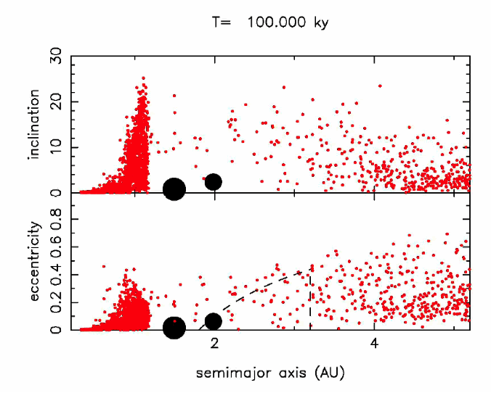
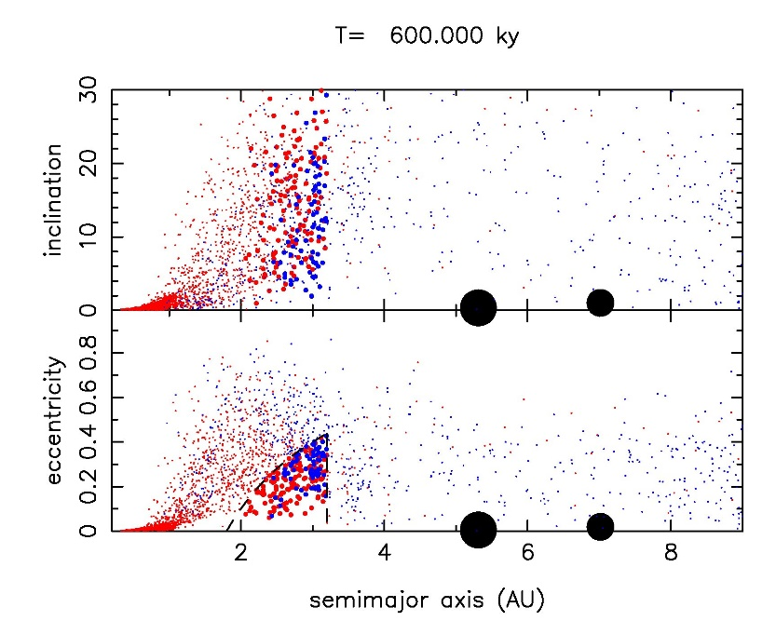
Sequence of events
http://perso.astrophy.u-bordeaux.fr/SRaymond/movies_grandtack.html

Slide 30
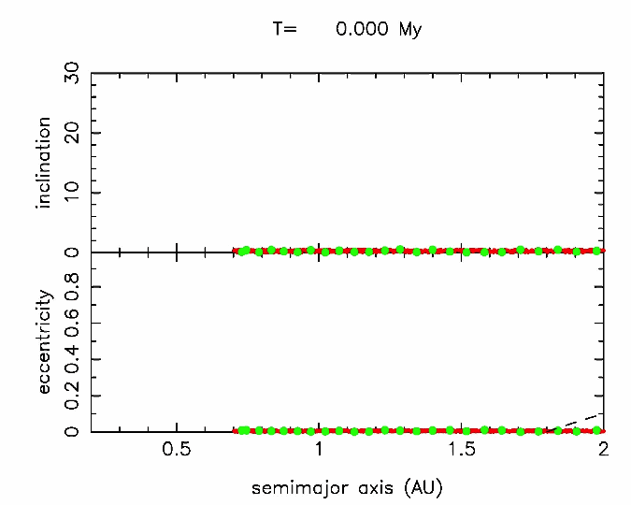
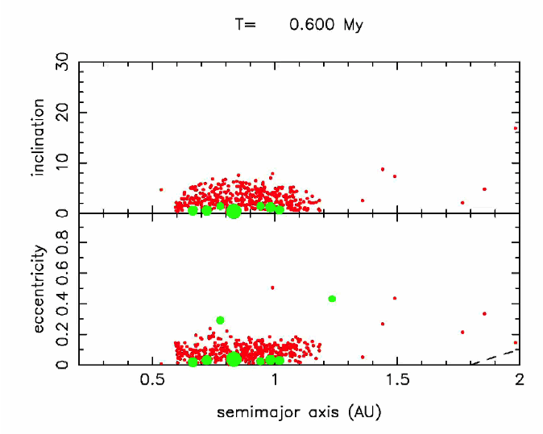
Disc of planetesimals: truncation
http://perso.astrophy.u-bordeaux.fr/SRaymond/movies_grandtack.html

Slide 31
Water on Earth from C-type asteroids
http://perso.astrophy.u-bordeaux.fr/SRaymond/movies_grandtack.html

Slide 32
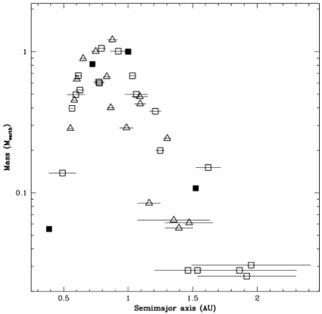
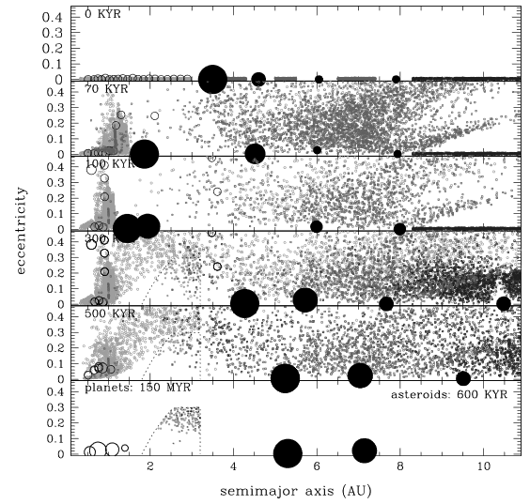
Mass distribution
http://perso.astrophy.u-bordeaux.fr/SRaymond/movies_grandtack.html
1409.6340

Slide 33
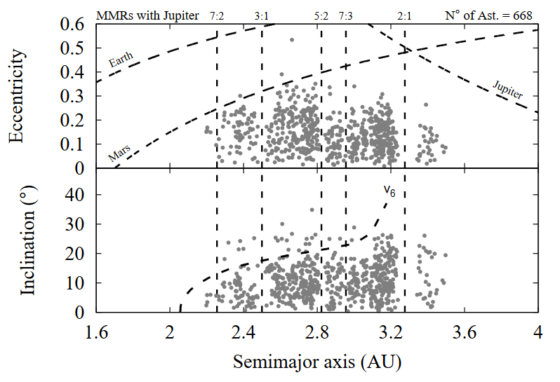
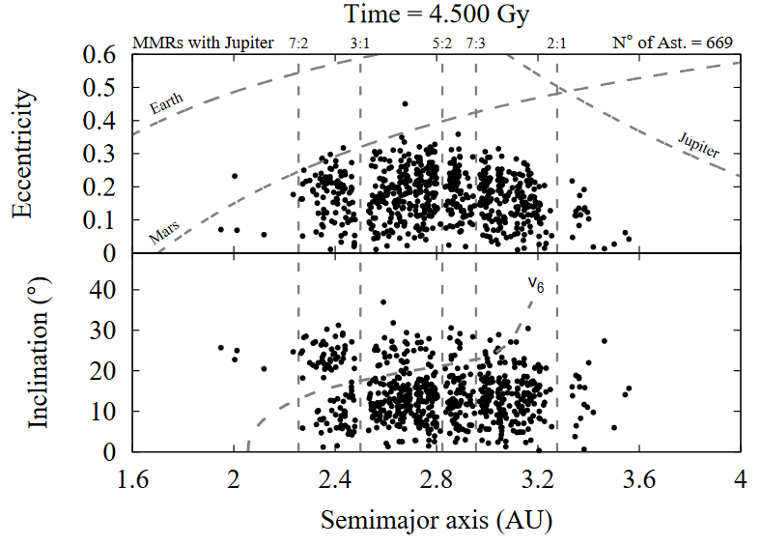
Asteroids and Grand Tack: details
Observed
1701.02775

Slide 34
Detailed comparison
Slightly larger than the observed value, but reasonable considering uncertainties.
1701.02775

Slide 35
Moon formation and Grand Tack
https://www.hou.usra.edu/meetings/lpsc2014/pdf/2274.pdf

Slide 36
Mars and Venus in Grand Tack
https://www.hou.usra.edu/meetings/lpsc2014/pdf/2274.pdf

Slide 37
Literature
Solar system formation 1501.03101 The formation of the solar system S. Pfalzner et al.
Radioisotopes dating 1005.4147 The Early Solar System M. Busso
MMSN 0903.5077 Minimum mass solar model Crida
Nice model Nature 435, 459 (2005) Tsiganis, K. et al.
Grand Tack 1409.6340 The Grand Tack model: a critical review Sean N. Raymond, Alessandro Morbidelli 1406.2697 Lunar and Terrestrial Planet Formation in the Grand Tack Scenario Seth A. Jacobson et al.

