Slide 1
Internal structure and atmospheres of planets
Sergei popov

Slide 2
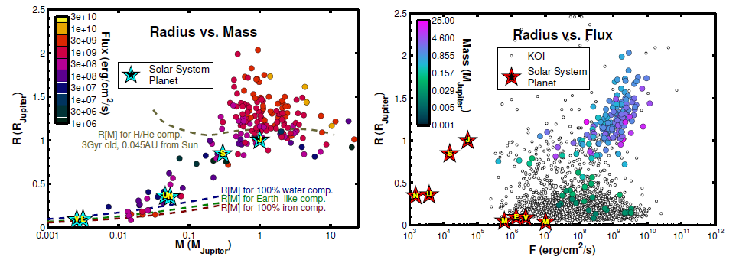
Sizes and masses
1312.3323

Slide 3
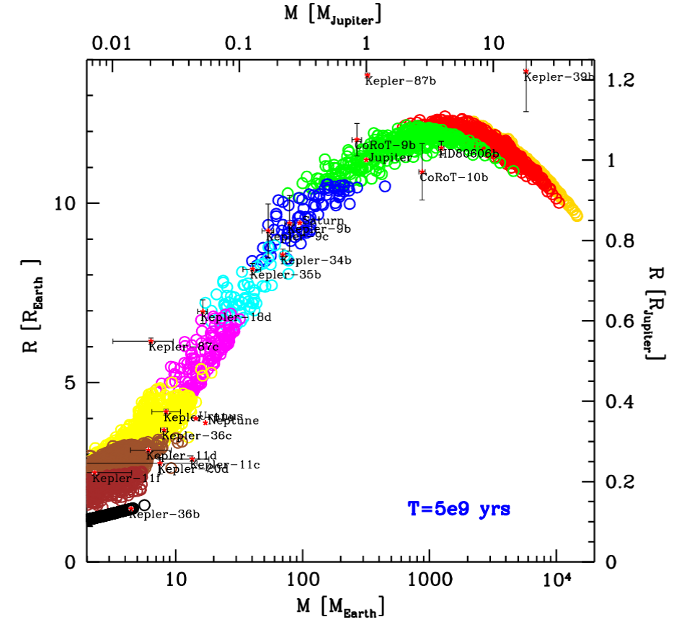
Radius vs. mass
Results of modeling. Old (relaxed) planets. Colors correspond to different fractions of light elements.
1604.07558

Slide 4
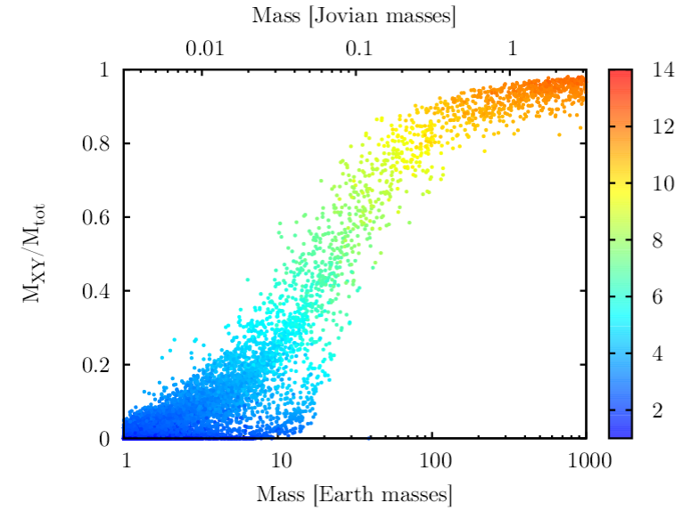
Light elements contribution
Results of modeling.
Different slopes above and below ~100 Earth masses are due to different regimes of gas accretion.
1604.07558

Slide 5
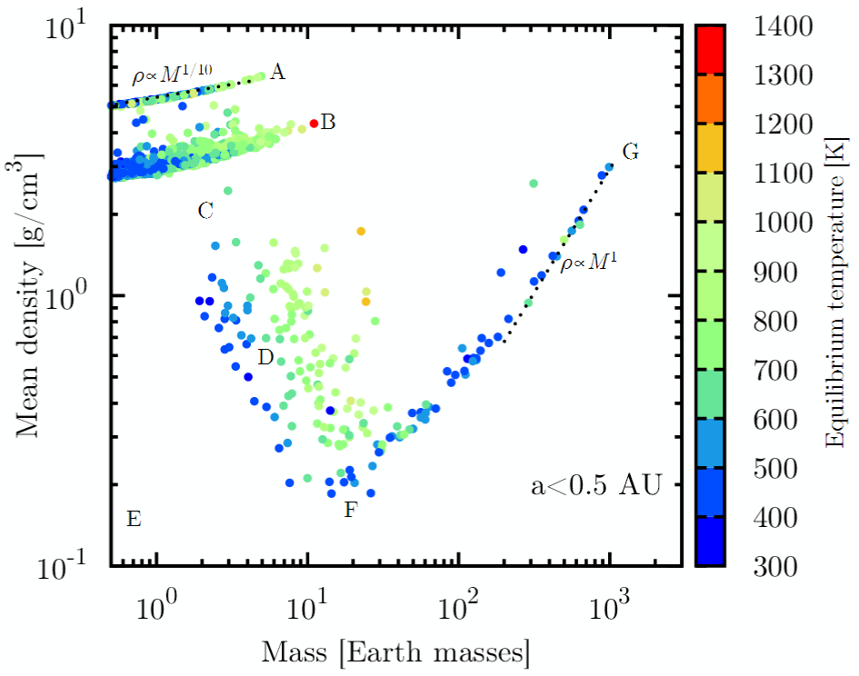
Density and mass
Results of modeling. Old (5 Gyrs) planets. A – solid iron-stone
B – solid ice
C – evaporating
D – low-mass planets with large cores, but with significant fraction of H and He
E – forbidden zone (evaporating)
F – transition to giants
G - giants
1604.07558

Slide 6
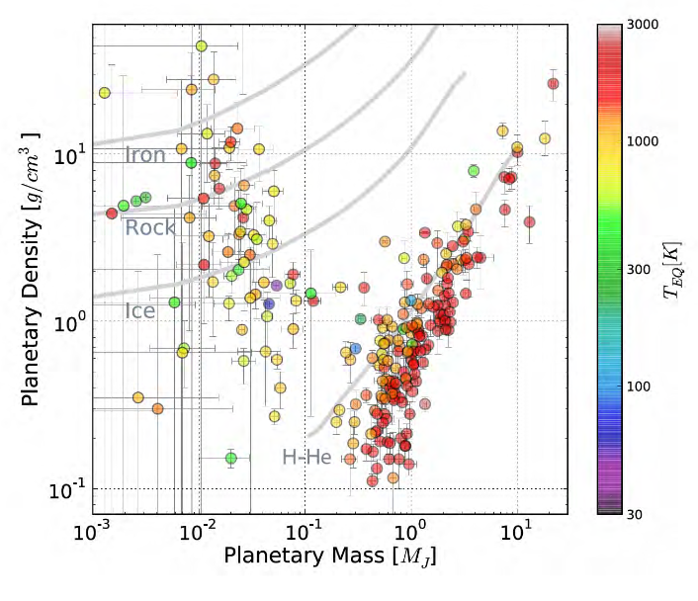
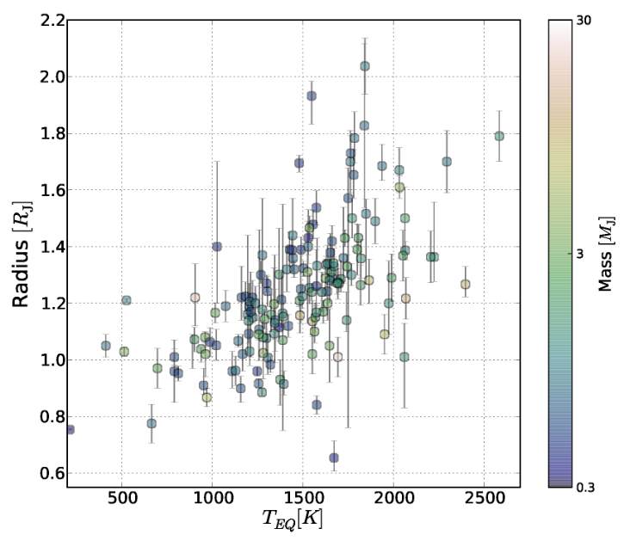
Mass-density. Observations. Heating.
1501.05685

Slide 7
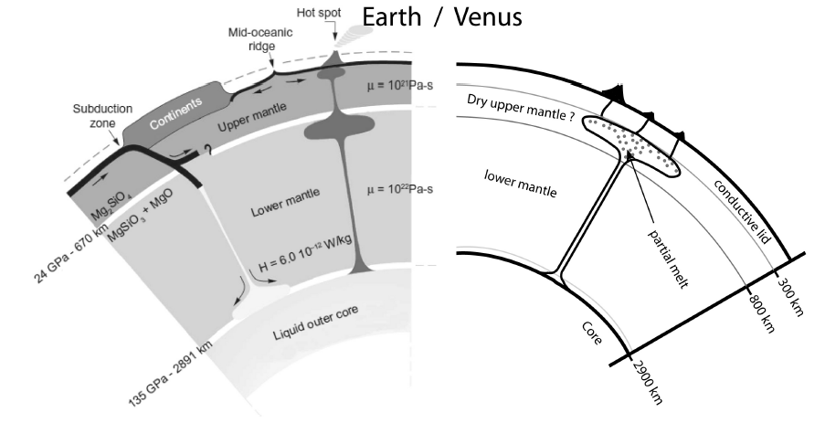
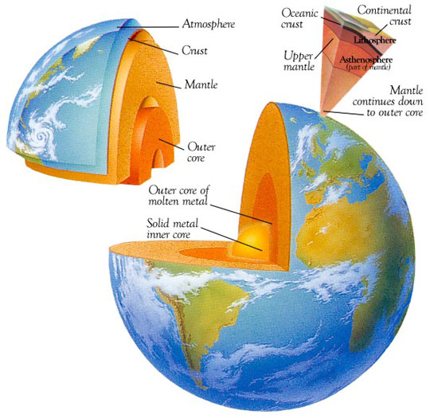
Planet structure
Even about the Earth we do not know many details of the internal structure. Data about other planets is very incomplete and indirect.
1312.3323

Slide 8
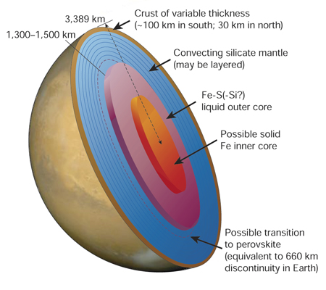
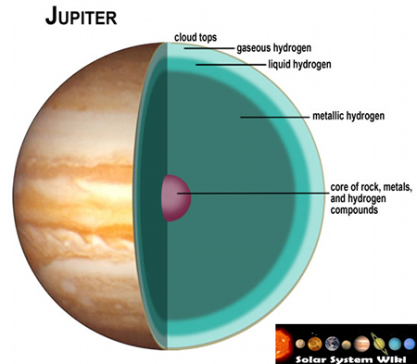
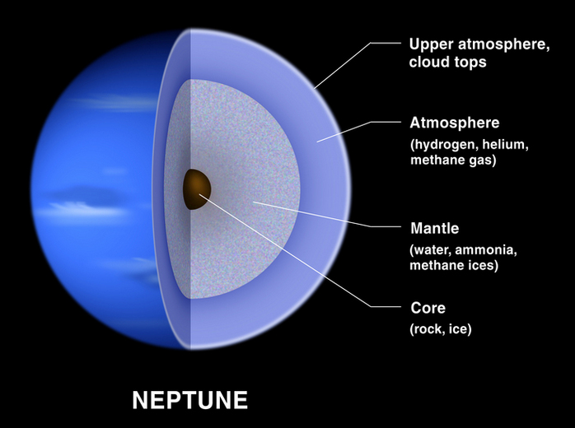
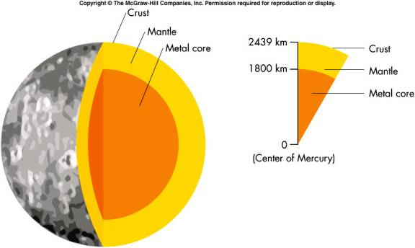
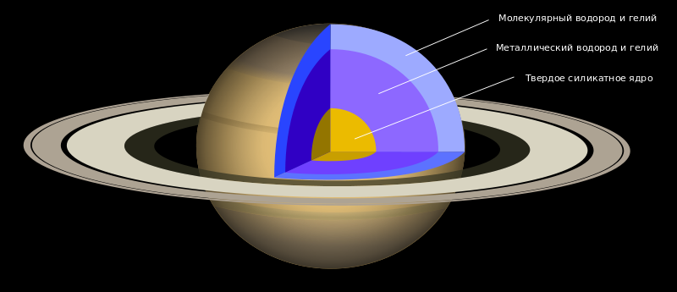
Structure of the Solar system planets
Notes:
https://solarsystem.nasa.gov/multimedia/display.cfm?IM_ID=283 http://cseligman.com/text/planets/marsstructure.htm http://www.thetimenow.com/astronomy/jupiter.php http://astro.physics.uiowa.edu/~srs/2952_EXW/Locus15_EXW.htm http://commons.wikimedia.org/wiki/File:Interior_of_Saturn.svg

Slide 9
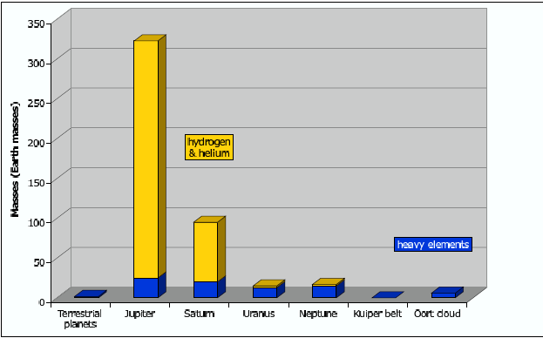
What Solar system planets are made of?
Except Jupiter and Saturn planets are mostly made of elements heavier than helium. Even icy-giants – Neptune and Uranus, -
are mainly made not of H+He.
1405.3752

Slide 10
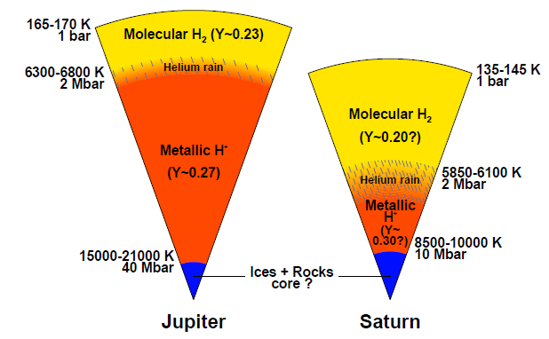
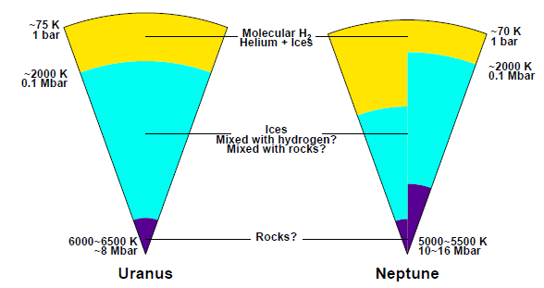
Structure of giant planets
Except Uranus giant planets might not have solid cores. However, there cores are made of heavy elements. And so often they are called made of rocks.
1405.3752

Slide 11
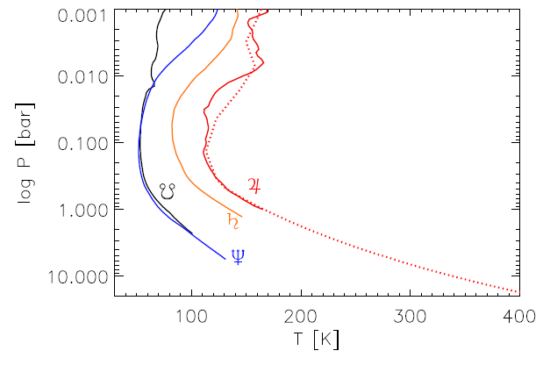
Temperature and pressure in atmospheres of giants
For Jupiter direct data are available due to Galileo probe measurements.
1405.3752

Slide 12
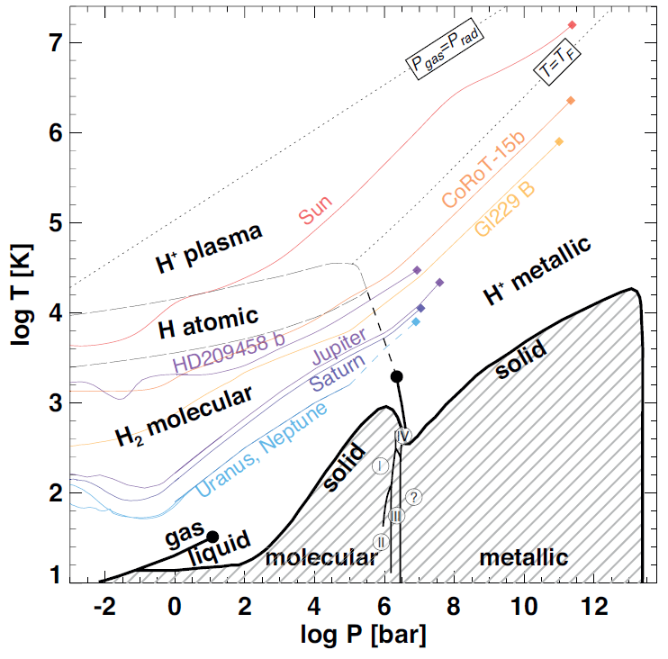
Hydrogene equation of state
Still, there are important uncertainties even for the hydrogen equation of state. Some regimes have been never measured in laboratories.
1405.3752

Slide 13
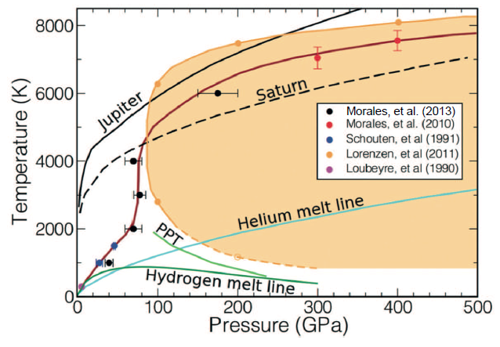
Hydrogen plus helium mixture
1405.3752

Slide 14
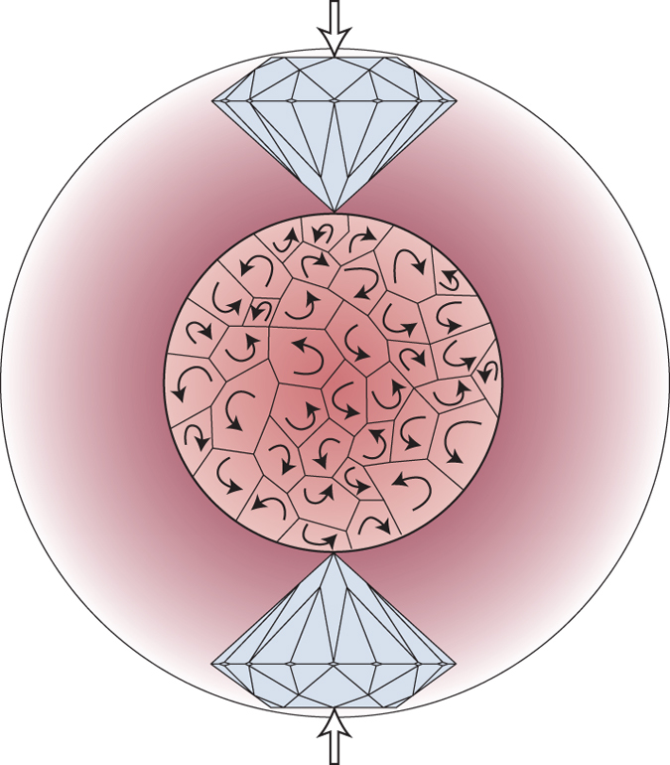
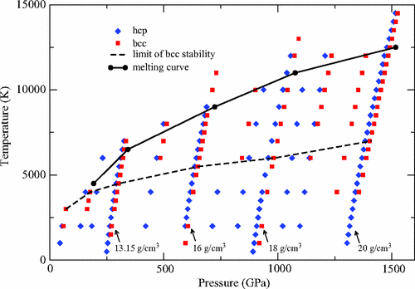
Diamond anvil cells
Diamond cells are used to reach high pressures in laboratory experiments.
However, it is not enough, and in many cases we have to base only on numerical models.
Merkel (2013)
Bouchet et al. (2013)

Slide 15
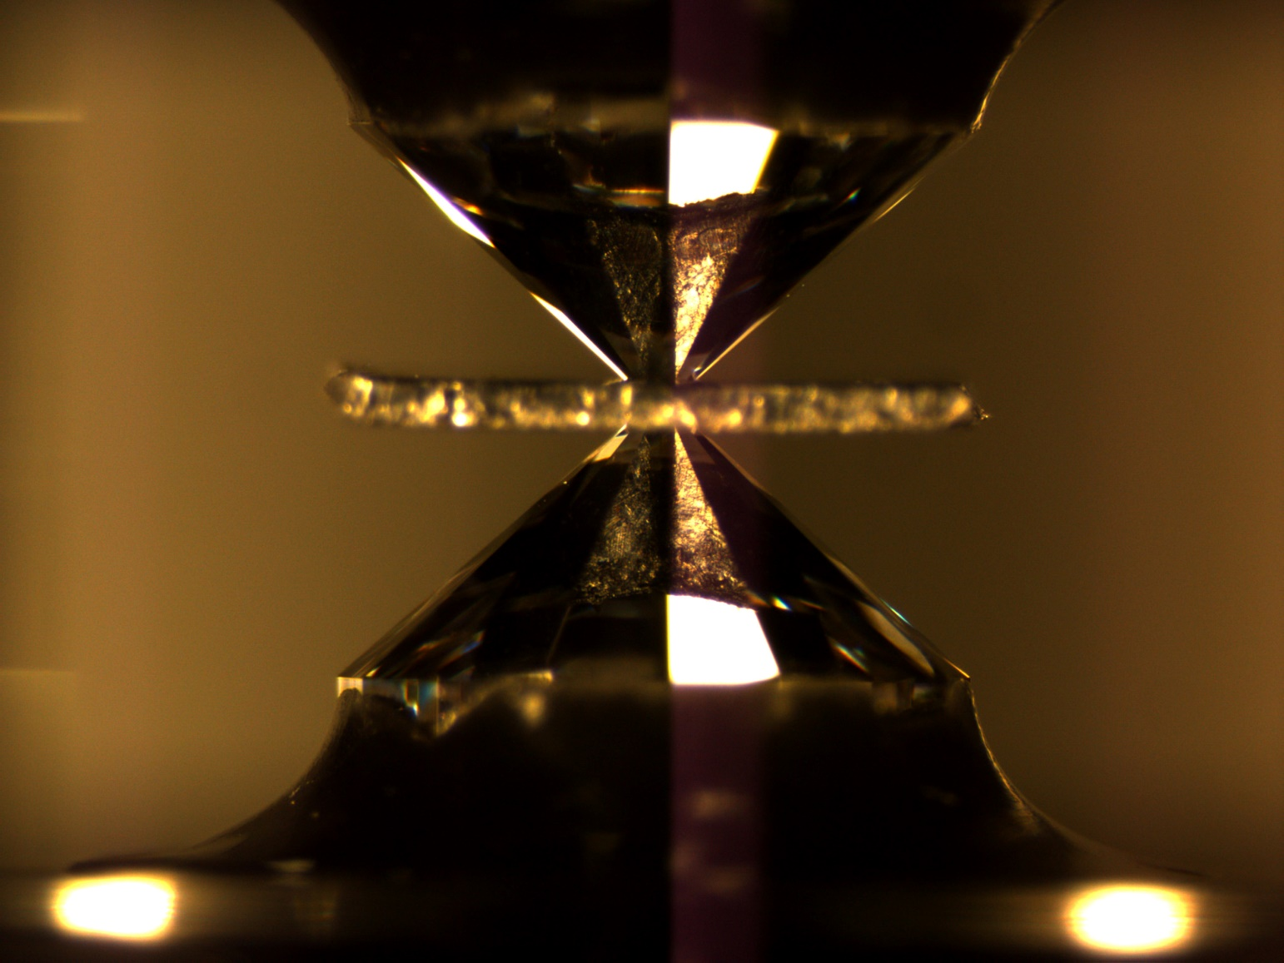
Diamond cell
http://serc.carleton.edu/NAGTWorkshops/mineralogy/mineral_physics/diamond_anvil.html

Slide 16
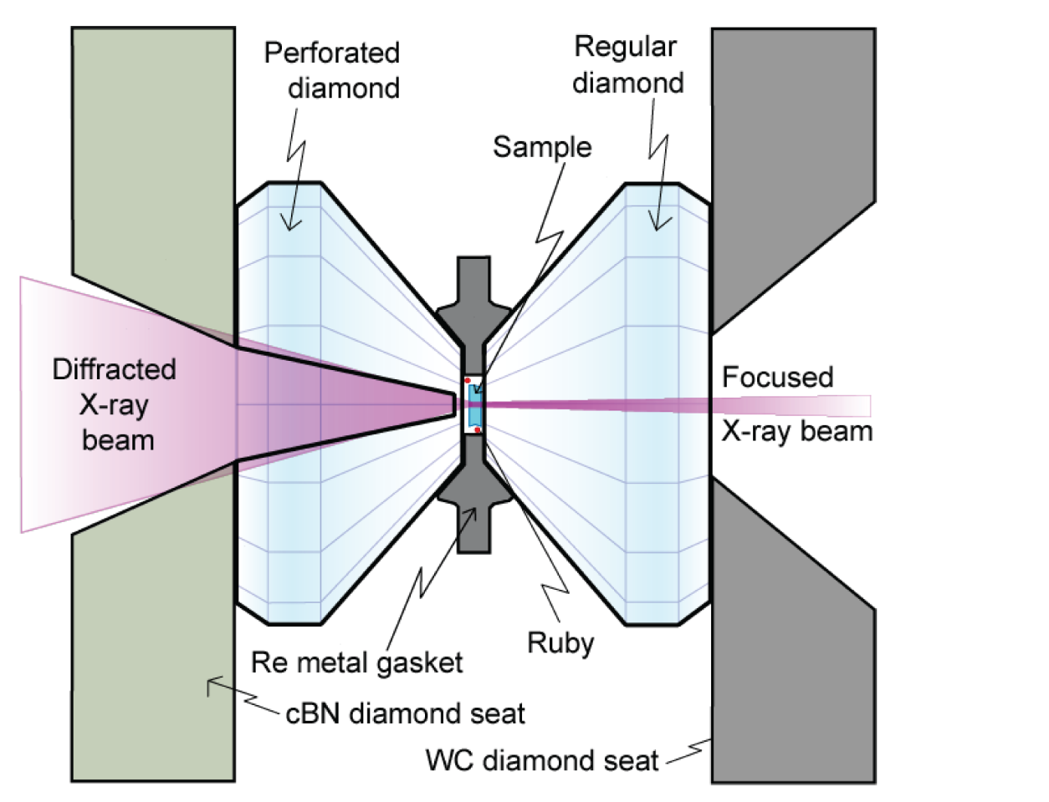
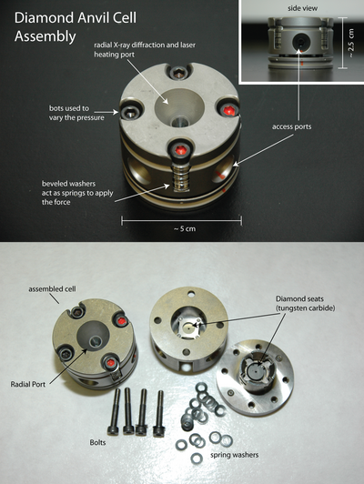
Scheme of the experiment
http://serc.carleton.edu/NAGTWorkshops/mineralogy/mineral_physics/diamond_anvil.html

Slide 17
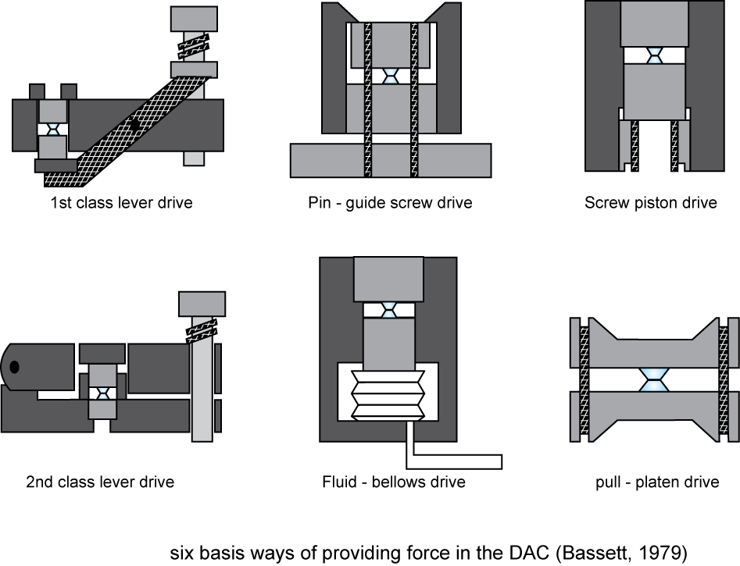
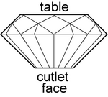
How to press?
http://serc.carleton.edu/NAGTWorkshops/mineralogy/mineral_physics/diamond_anvil.html

Slide 18
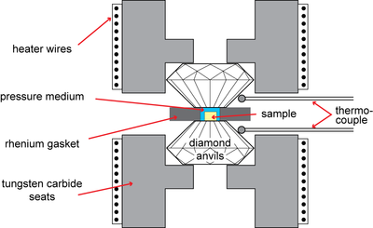
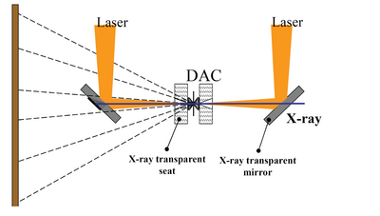
How to heat the matter
Electric current (for lower temperatures) or laser (for higher temperature).
Up to 1300К
Above 1300К
http://serc.carleton.edu/NAGTWorkshops/mineralogy/mineral_physics/diamond_anvil.html

Slide 19
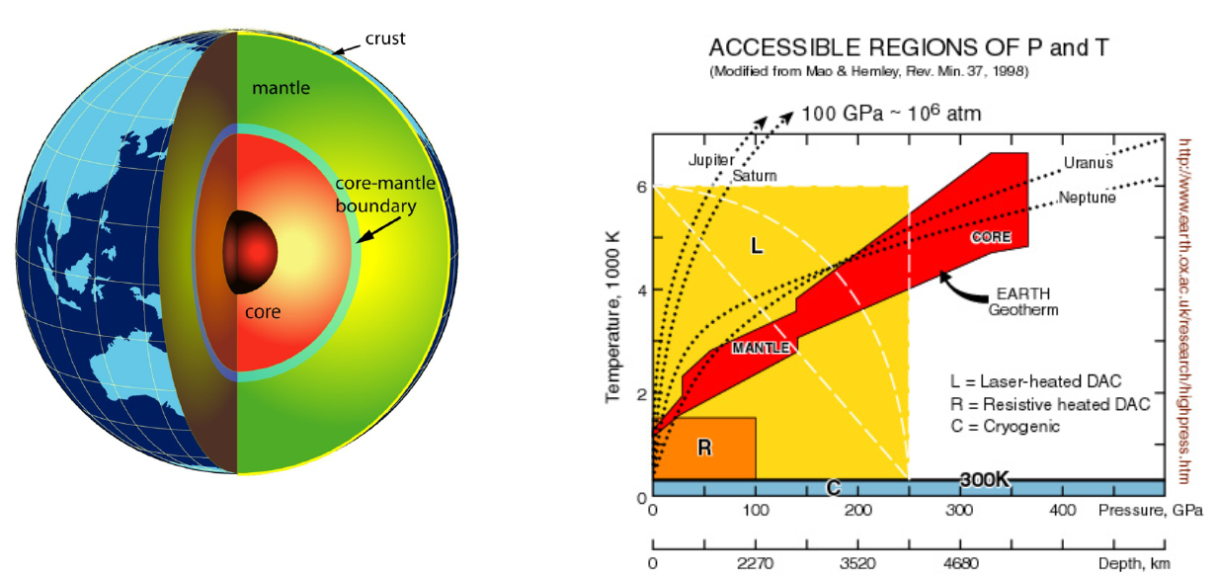
Comparison with conditions in the Earth
http://mini.physics.sunysb.edu/~pstephens/downloadable/ehm_dac.pdf

Slide 20
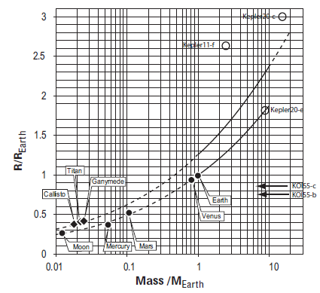
Mass-radius models for planets
Relatively simple model based on just 8 key elements.
Good results for Solar system planets.
1401.4738

Slide 21
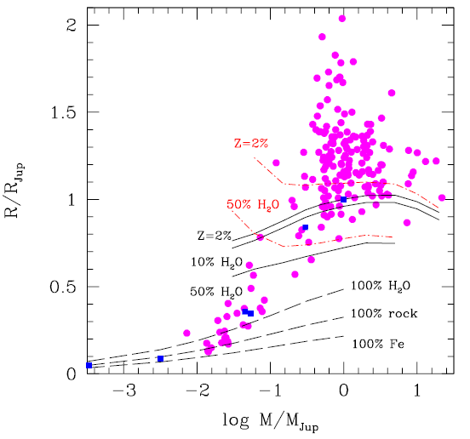
Mass-radius diagram for exoplanets
Planet radius, of course, depends on its composition.
Light planets typically do not have extended gas envelopes.
Oppositely, giant planets might hath very thick gas envelopes.
Very often data on mass and radius can be explained by different combinations of ingredients.
1401.4738

Slide 22
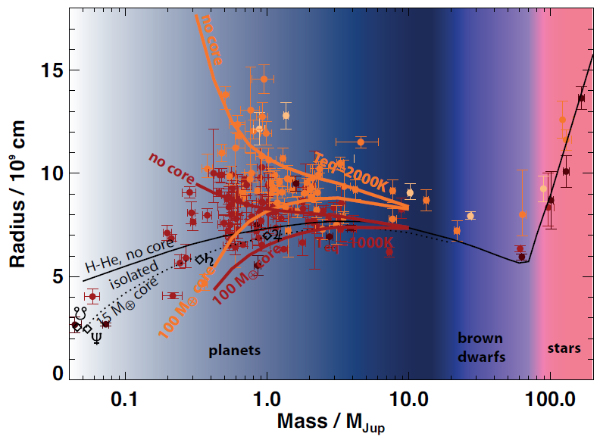
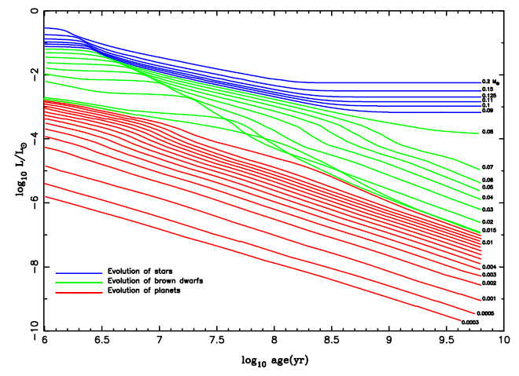
Theory vs. observations
1405.3752

Slide 23
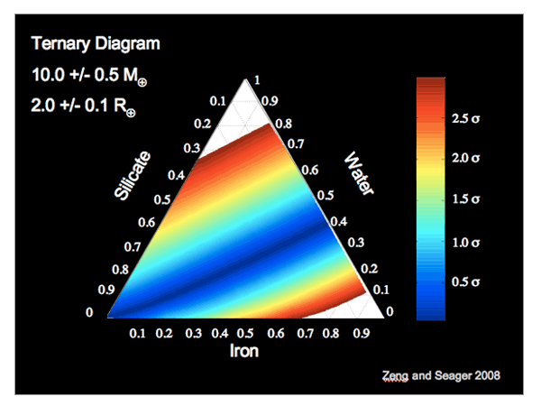
Three main ingredients: gas, ice, rock
http://seagerexoplanets.mit.edu/research.htm

Slide 24
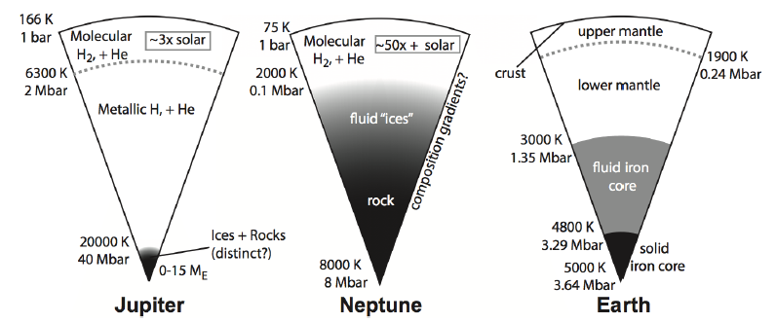
Three main types of planets
Gas giants Icy giants Solid planets H/He H/He+ice+core Si, Mg, Fe, O, C
1312.3323

Slide 25
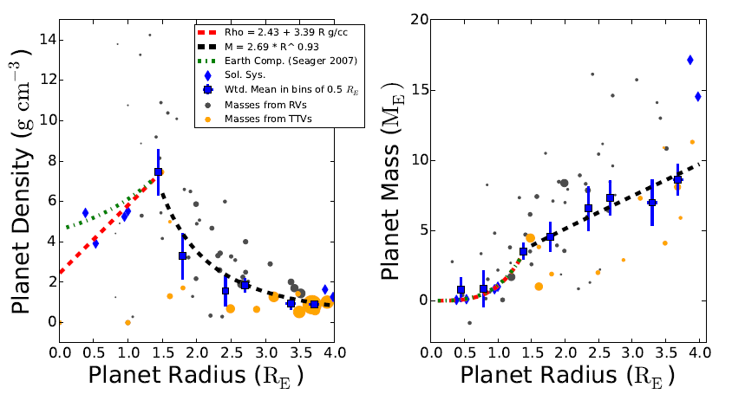
Thick atmospheres for M>4M_{Earth}
1312.0936

Slide 26
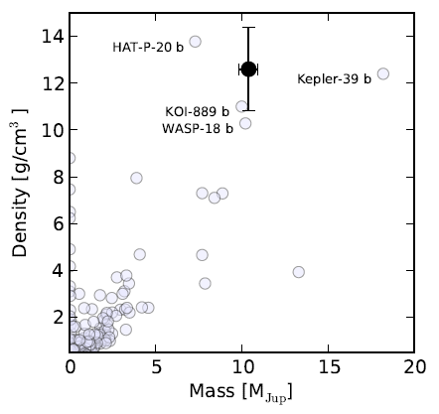
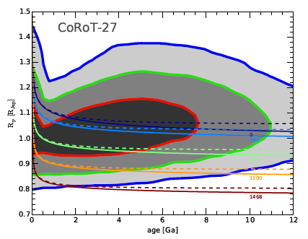
Corot-27b. Dense planet
Orbital period 3.6 days. Solar-like star
1401.1122

Slide 27
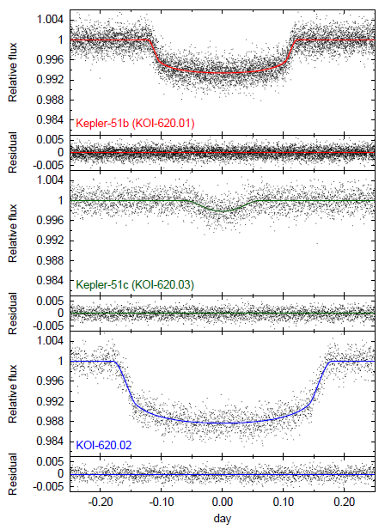
Kepler-51. Crumbly planets.
Solar type star. Three planets with masses 2-8 M_{earth} and low densities: <0.05 g/cm³
Orbital periods 45-130 days.
1401.2885

Slide 28
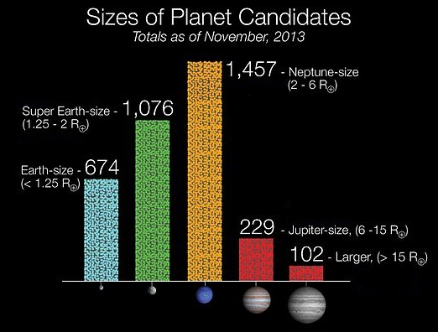
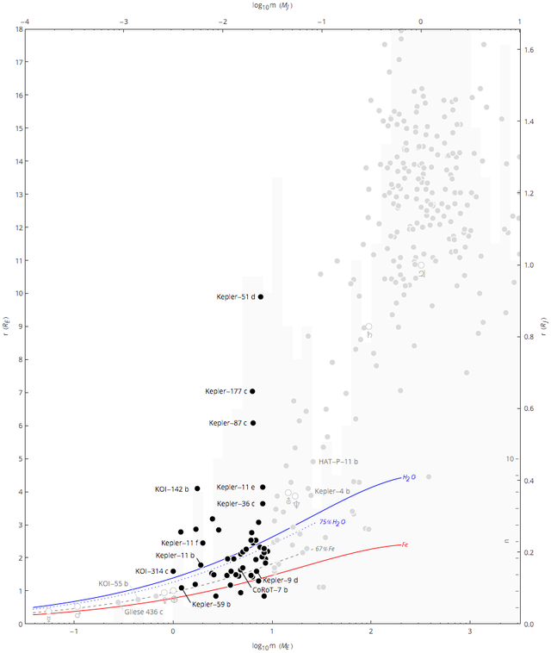
Superearths. Diversity of properties.
Wikipedia

Slide 29
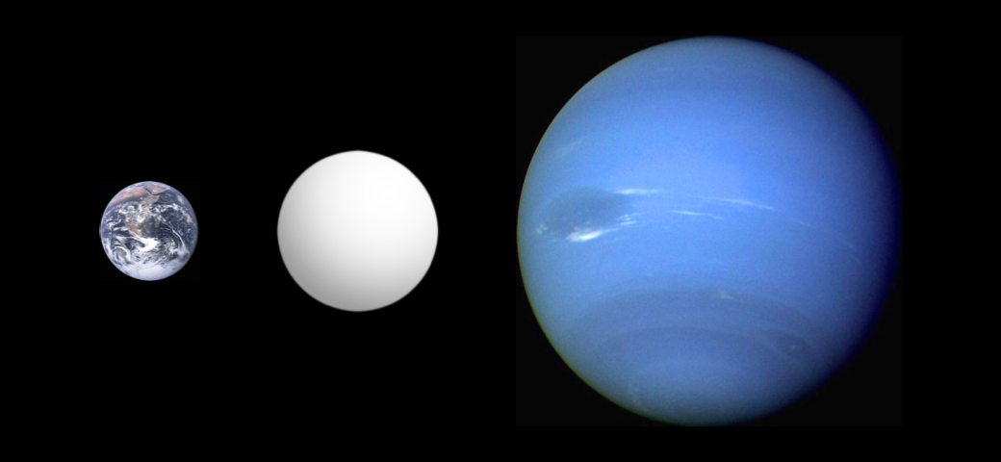
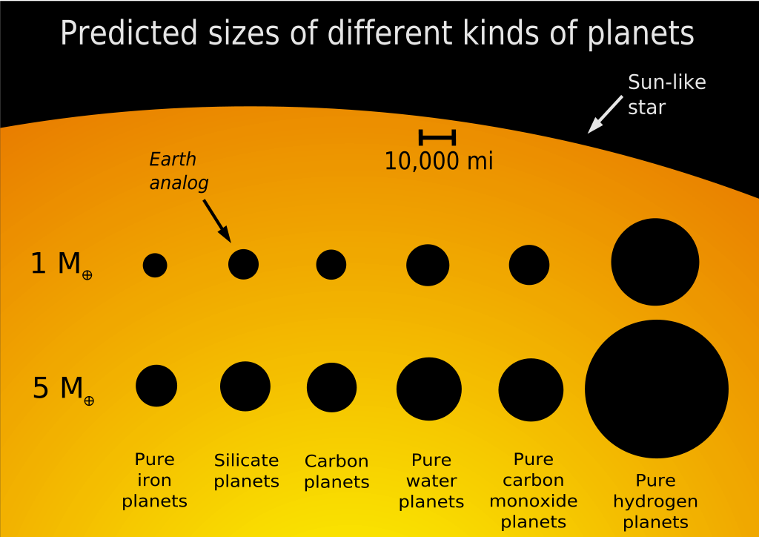
Sizes of superearths
Wikipedia
Corot-7b
Typical radii 1-4 of the Earth I.e., between the Earth and Neptune). Sometimes low density planets in the range are called mini-Neptunes.

Slide 30
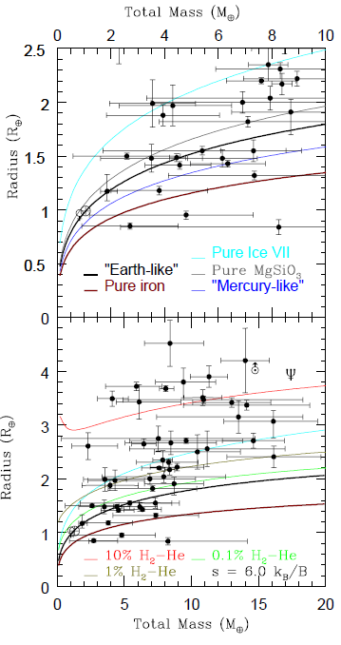
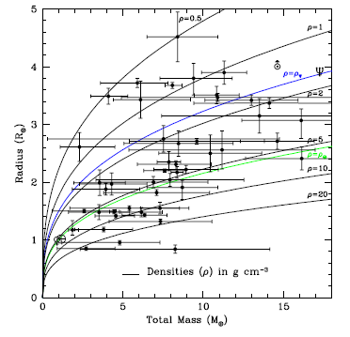
Superearths: mass-radius
Superearths are very numerous planets. Only those with well-determined mass and radius are shown.
Inner cores can consist either of rocks (and iron) or of ices.
Some of superearths obviously have thick gas envelopes. This is a challenge to formation models.
1402.4818

Slide 31
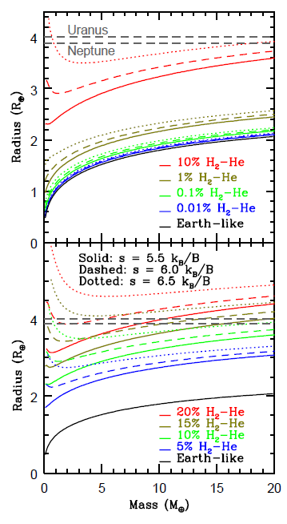
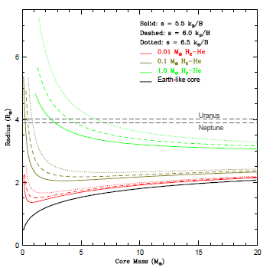
Superearths models
For less massive planets parameters are mainly determined by the core. For more massive – by the outer envelope.
Heating can be also important.
Results are shown for planets with solid earth-type cores.
1402.4818

Slide 32
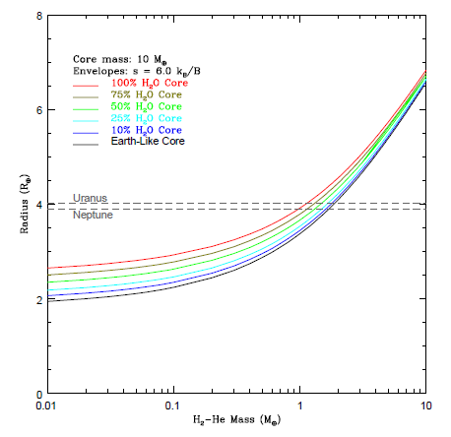
Just add water
Let us fix the planet mass and change the fraction of ice. Here water is added as an ice layer above a solid (rocky) core. Only for lower masses it is possible to distinguish (by radius measurements) between pure-ice cores and pure-rock cores.
1402.4818

Slide 33
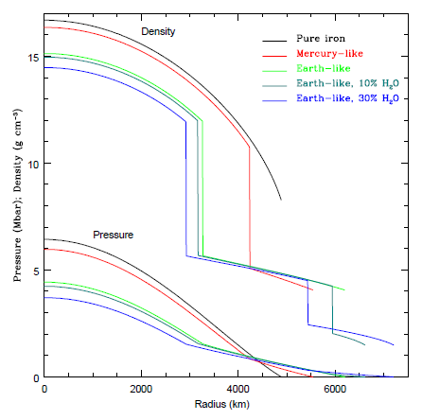
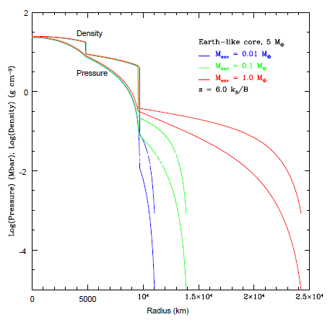
Internal structure
Without an envelope
With an envelope
1402.4818

Slide 34
Under pressure
Interiors might have high pressure and density
1402.4818

Slide 35
Soil and water
Wikipedia
Radius vs. mass for different water content
1402.4818

Slide 36
Atmospheres

Slide 37
Transits and atmosphere studies
1709.05941

Slide 38
Transits and atmospheres
Transit observations in different wavelengths allow to determine properties of the planet atmosphere. Size can be different in different wavelengths. In addition, light curve can look different due to atmospheric dynamics. Heat redistribution due to strong winds modifies the flux from the planet.
1302.1141
1407.4150

Slide 39
Featureless spectrum of GJ 1214b
Obscured by clouds. Hubble space telescope spectrum shows no details. This is interpreted as the result of the presence of a thick cloud layer in the outer atmosphere of the planet.
1401.0022

Slide 40
Phase dependence
Depending on the phase we observe different parts of a disc.
Results of observations correspond to:
HD 189733b – upper panel; HD 209458b – lower panel.
Both planets are hot jupiters.
Note, that in the case of HD 209458b planetary disc is strongly non-symmetric in terms of the emitted flux.
1407.4150

Slide 41
Scanning planetary discs
HD189733b
Spitzer space telescope
1202.3829

Slide 42
Dynamics of outer layers of hot jupiters
Planet has internal and external heat sources.
This results in violent winds and convection in the outer gas envelope.
1405.3752

Slide 43
Wind on HD 209458
Wind velocity can be directly (!) measured. The planet is a VERY hot Jupiter. Wind velocity is ~ 2 km/s
1006.4364

Slide 44
Modeling winds on hot jupiters
General property: Strong equatorial wind from the West to the East.
1407.4150

Slide 45
Modeling of HD209458 b
Osiris
1405.3752

Slide 46
Exomoons: how to form
Regular satellites Are formed together with planets from the circumplanetary disc
Irregular satellites Capture or collision

Slide 47
Giant ring system
System of 37 rings extending up to 0.6 AU around a stellar companion. The star is young (16 Myrs), and so, probably, the system of rings is just forming. Satellites might regulate the shape of the ring system.
1501.05652

Slide 48
Which planets might have detectable satellites?
To be large respect to the host-planet the satellite might be irregular.
http://www.freemars.org/jeff/planets/Luna/Luna.htm
Systems with many planets are more favorable.
Larger planets have larger moons.
Hot jupiters (and neptunes) can loose planets during migration.
http://minerva.union.edu/parkashv/hotjupiters.html

Slide 49
Modeling satellite formation
A massive planet: 10 M_{jupiter}
1408.6164

Slide 50
Satellite capture in three-body interaction
Results of modeling of a satellite capture. The body initially had a companion which was lost during three-body interaction. This scenario requires a massive planet. Such interactions can happen in the habitable zone.
1408.6164

Slide 51
How to find an exomoon
Potentially, all methods for exoplanets discovery can work. However, presently methods related to transits seems to be more favorable:
1. TTV 2. TDV 3. Orbital plane changes.
1405.1455

Slide 52
Joint transits
1405.1455

Slide 53
How strong is the effect?
1408.6164

Slide 54
An example: Jupiter with satellites over the Sun
1503.03251

Slide 55
A planet with a moon …but without a star?
Microlensing. Two solutions are possible: 1. 0.12M_{sun}+18M_{Earth} 2. 4M_{Jup}+0.5M_{Earth} Uncertainty is related to unknown distance
1312.3951

Slide 56
New measurements and a candidate
Kepler-1625BI Semimajor axis: 20 planet radii. Jupiter-like planet. Planet orbit: 0.8 AU
1707.08563

Slide 57
Tidal heating
Satellites can be heated by tides. Effect can be so strong, that a satellite with an atmosphere can experience the greenhouse effect.
1408.6164

Slide 58
Planetary magnetospheres
It is argued that magnetic shield can be important for life. A satellite can ``use’’ the planetary field. However, if the satellite is too close to the planet – then tides can heat it up. If it is too far – it can be out of the magnetosphere.
1408.6164

Slide 59
Can JWST see exomoons?
A satellite might be large (as the Earth) and warm (also as the Earth, at least).
Potentially, such satellites can appear around massive planets far from the star, where it is easier to see them. A satellite can be heated by tides.
1408.6164

Slide 60
Literature
arxiv:1604.06092 Exoplanetary Atmospheres - Chemistry, Formation Conditions, and Habitability
arxiv:1507.03966 Observations of Exoplanet Atmospheres
arxiv:1401.4738 Planetary internal structures
arxiv:1312.3323 The Structure of Exoplanets
arxiv:1501.05685 Exoplanetary Geophysics -- An Emerging Discipline
arxiv:1701.00493 Illusion and Reality in the Atmospheres of Exoplanets
arxiv:1411.1740 Seismology of Giant Planets
arxiv:1709.05941 Exoplanet Atmosphere Measurements from Transmission Spectroscopy and other Planet-Star Combined Light Observations

