Slide 1
Star-planet coalescence
Sergei Popov, aleksandr popkov

Slide 2
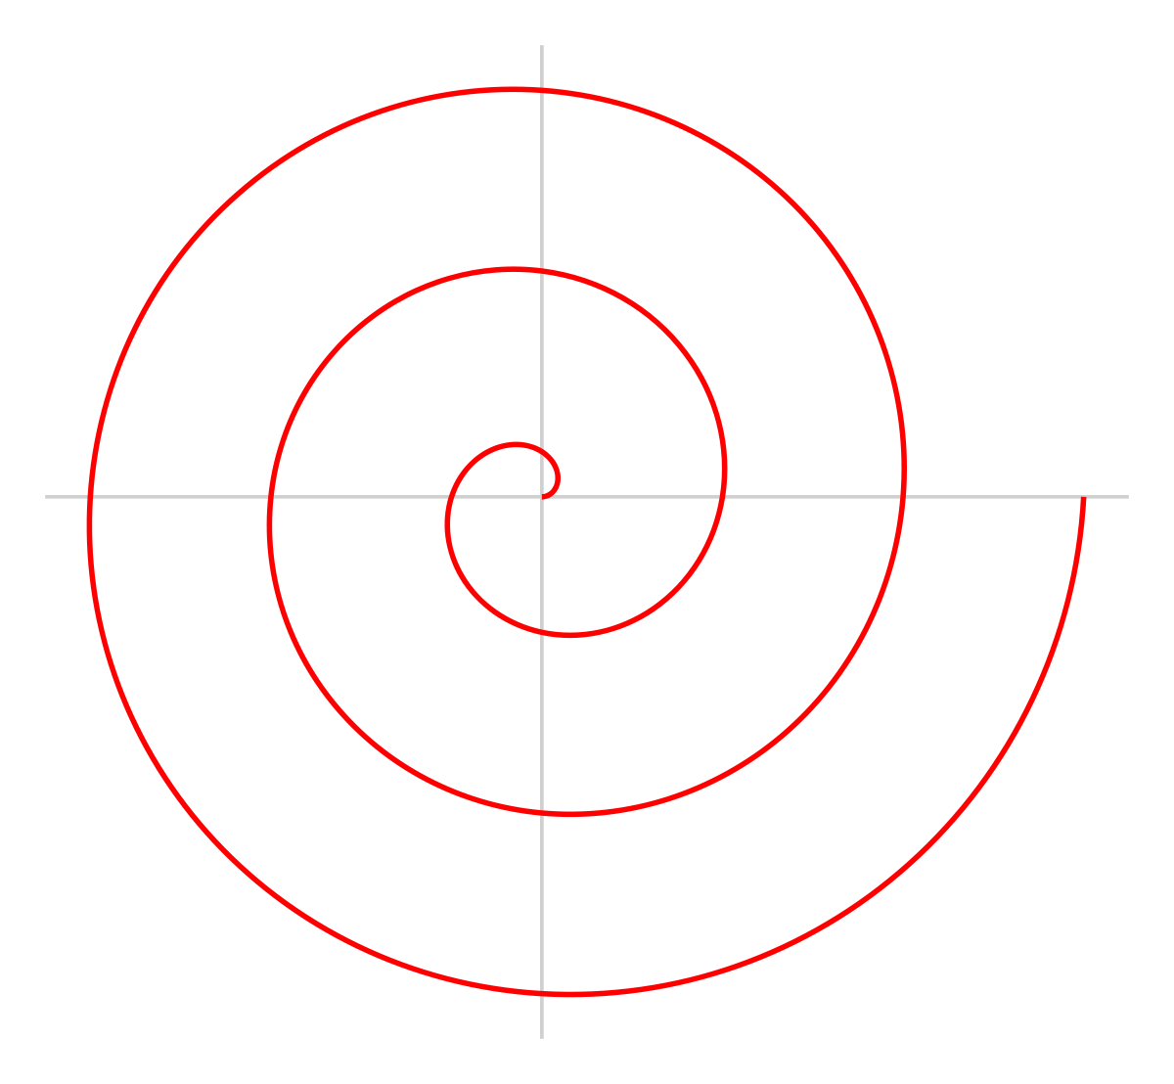
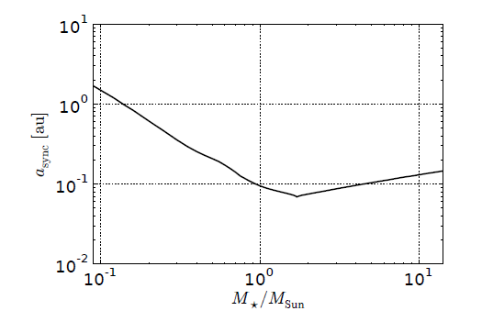
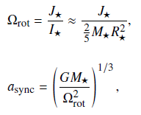
Tidal interaction

Slide 3
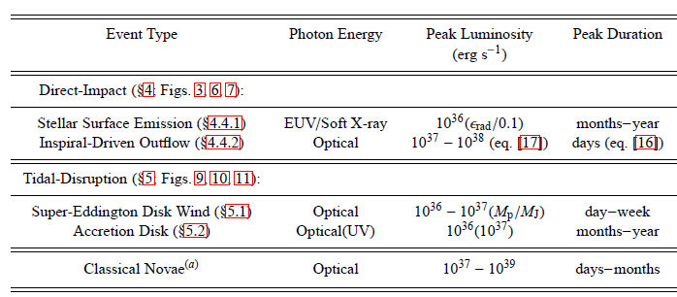
Types of mergers
Stable accretion ρ_{pl}<ρ*
Tidal disruption 1<ρ_{pl}/ρ*<5
Direct impact ρ_{pl}>5ρ*
Metzger et al. 2012

Slide 4
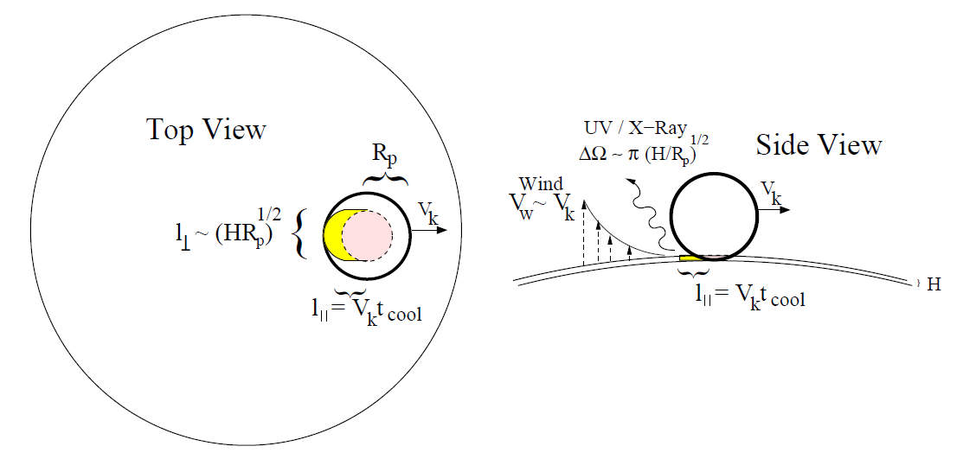
Direct impact dinamics
Metzger et al. 2012

Slide 5
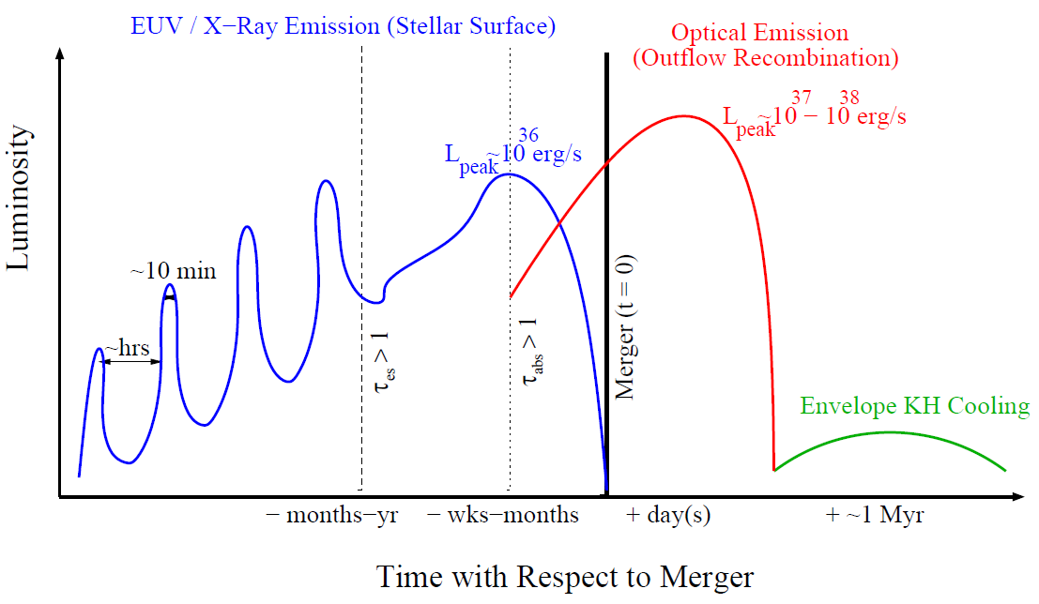
Direct impact luminosity

Slide 6
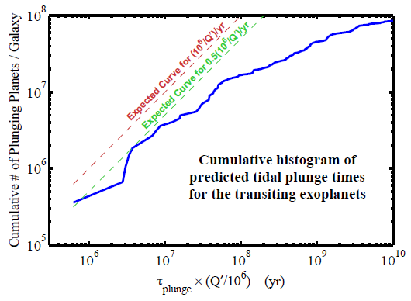
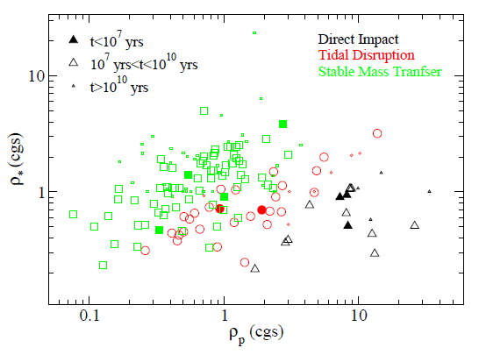
Estimates by Metzger et al. (2012)
Numbers can reach 0.1-1 mergers per year!

Slide 7
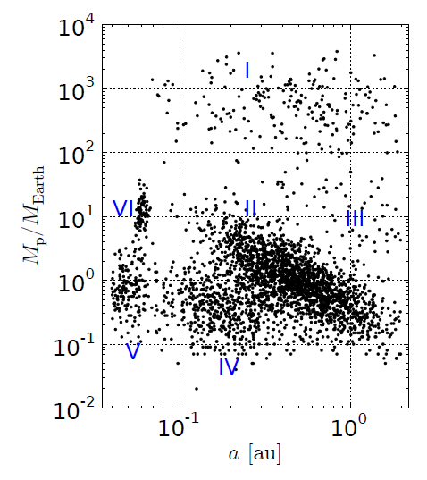
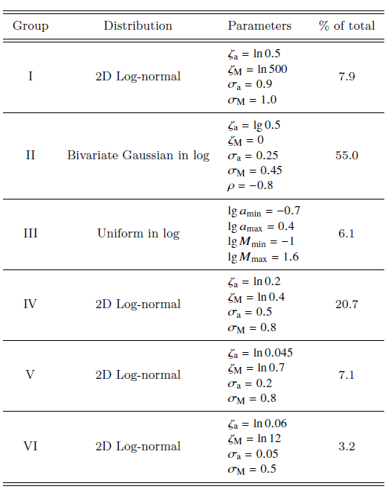
M-a distribution
Initial distribution
in a-M plane is taken from
population synthesis.

Slide 8
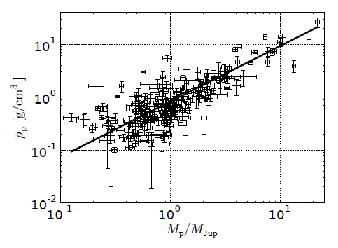
Planetary parameters

Slide 9
Other perameters
Disc lifetime
Stellar IMF
Galactic star formation rate

Slide 10
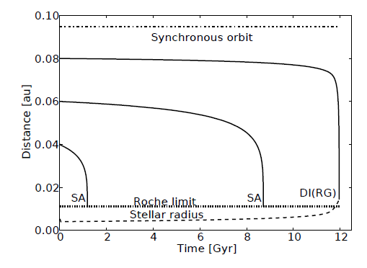
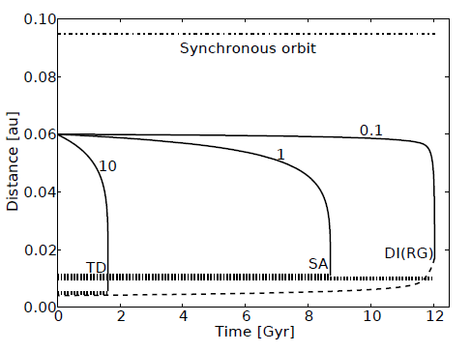
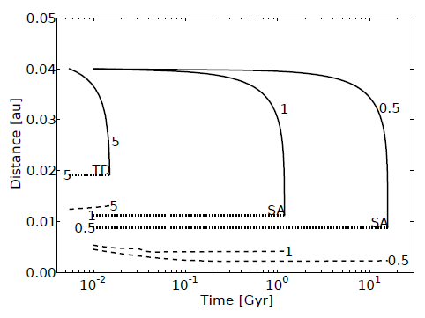
Tidal evolution

Slide 11
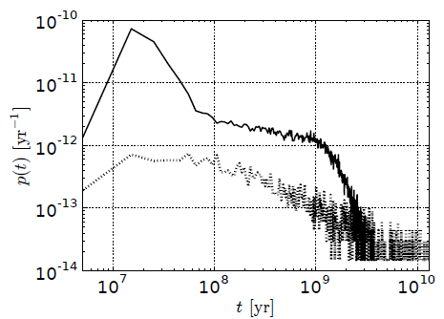
Results-1
Probability of a merger of a planet with a main sequence
host star vs. system's age, p(t).
Line style marks the type of merger:
solid curve - direct impact,
dotted curve - tidal disruption.

Slide 12
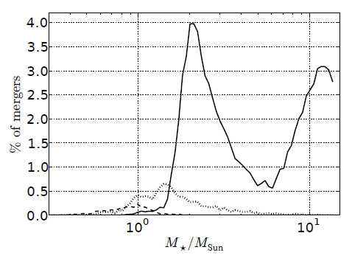
Distribution of stellar masses for mergers
Distribution of mergers with main sequence stars.
Curves show fraction of merging planets
depending on the host mass (given in solar units).
Only coalescences which happened at ages
less than the age of the Galaxy are taken into account.
Solid line - direct impacts,
dotted line - tidal disruptions,
dashedline - stable accretion events.

Slide 13
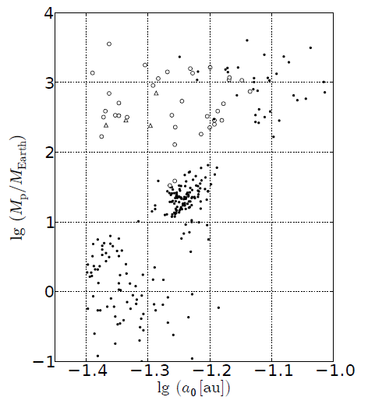
Which planets merge?
Mass and initial orbital radius of planets which merge
with their host stars during the main sequence phase in simultaneously formed population of planetary systems.
Symbol style marks the type of mergers:
dots - direct impacts,
circles – tidal disruptions,
triangles - stable accretion events.
Only mergers happening at ages less than the age of the Galaxy are included.
Total number of planets in the population is 10⁵,
the number of planets on this diagram is 269.

Slide 14
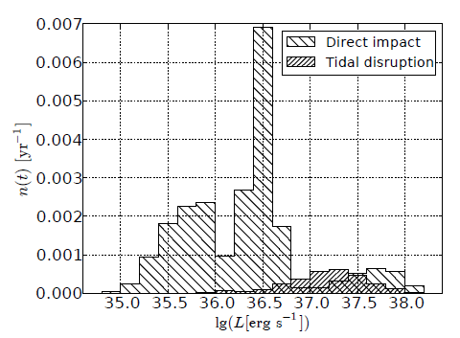
Luminosity distribution of mergers
Distribution in luminosity of planet-star mergers
in a Milky Way-like galaxy.
Type of merger is marked by hatching.
The quantity on the ordinate is the rate of mergers per year per galaxy in a luminosity bin.

Slide 15
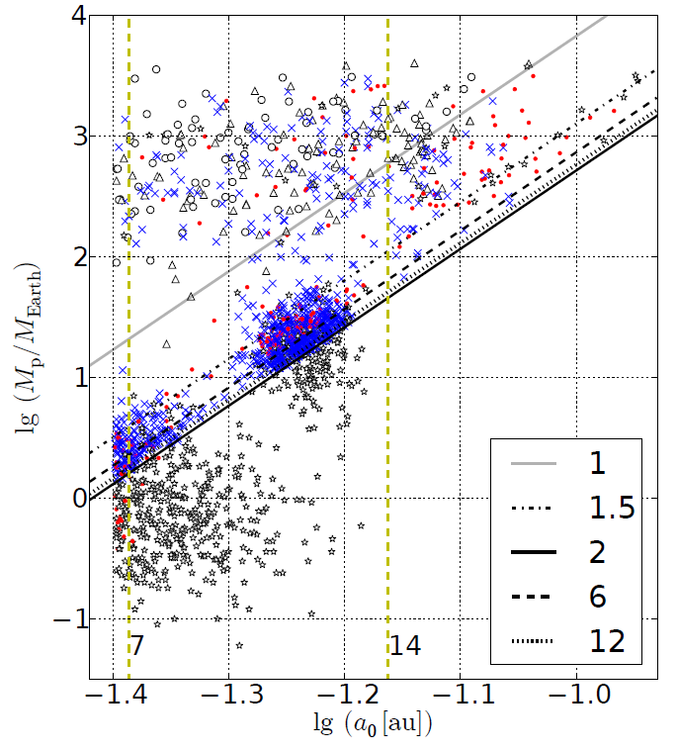
Dependences
Illustration of the dependence of coalescence statistics on initial distribution in the a-M plane.
Symbols encode host star masses:
Circles: 0.09-1 Msolar; triangles: 1-1.5 Msolar; crosses: 1.5-4 Msolar; dots: 4-7 Msolar; stars: 7-14 Msolar.
Inclined lines mark the
boundary of the “fall region" for stars of different masses (labeled in the legend in units of the Solar mass).
The solid line on the top corresponds to 1 Msolar.
Maximum radii of stars of 7 and 14 Msolar at the end of their evolution on the main sequence are plotted by vertical dashed lines and marked by the value of mass.

