Slide 1
Population synthesis of exoplanets
Sergei popov

Slide 2
Population synthesis in astrophysics
A population synthesis is a method of a direct modeling of relatively large populations
of weakly interacting objects with non-trivial evolution.
As a rule, the evolution of the objects is followed from their birth up to the present moment.
Evolutionary and Empirical
Evolutionary PS. The evolution is followed from some early stage.
Typically, an artificial population is formed (especially, in Monte Carlo simulations)
Empirical PS.
It is used, for example, to study integral properties (speсtra) of unresolved populations.
A library of spectra is used to predict integral properties.
astro-ph/0411792

Slide 3
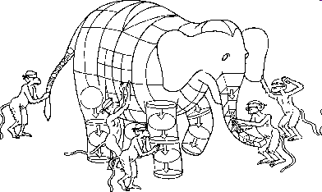
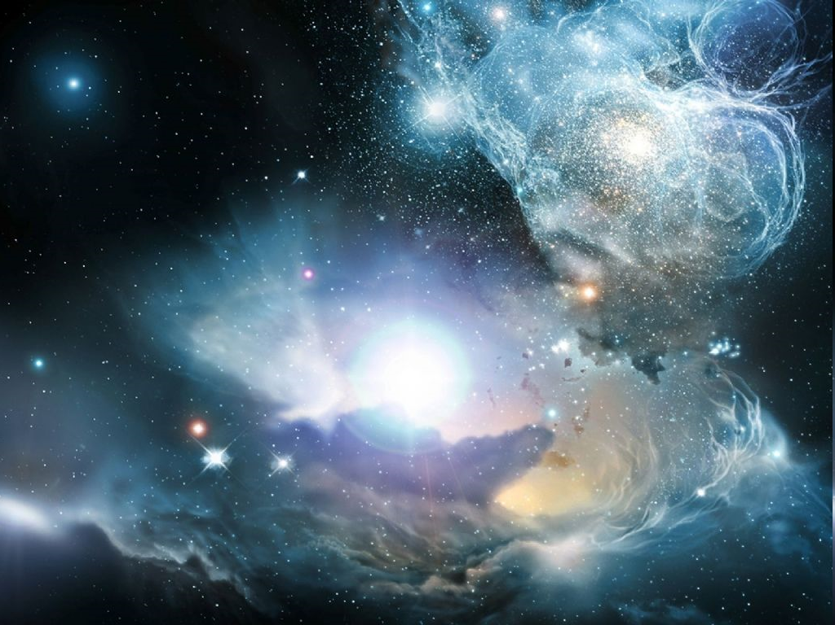
Ingredients: - initial condition - evolutionary laws
Modeling observations
«Artificial observed universe»
«Artificial universe»

Slide 4
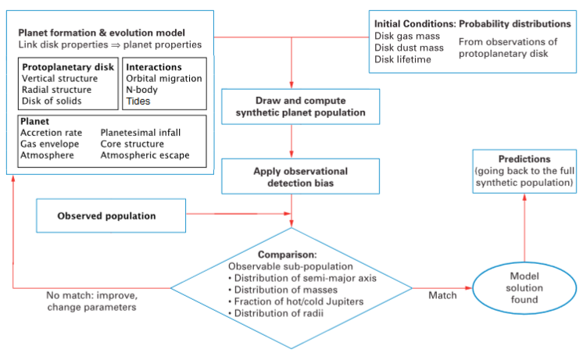
Incredients for planetary PS
1804.01532

Slide 5
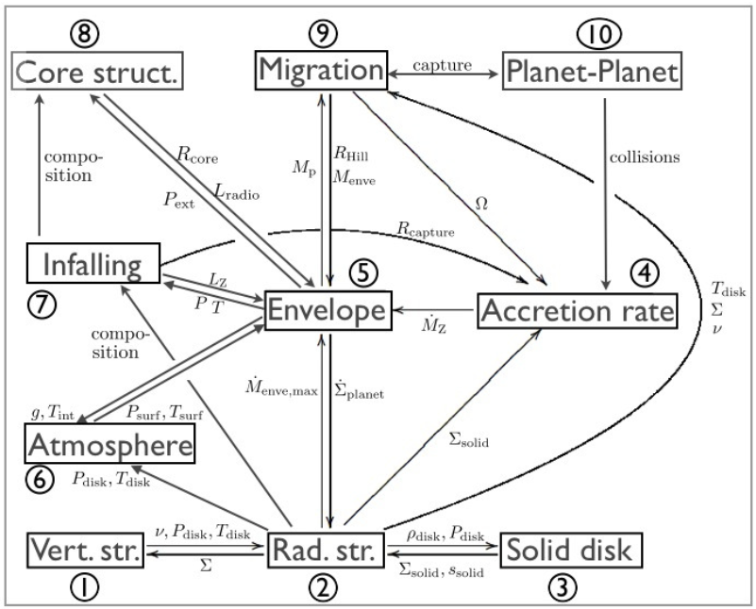
1402.7086

Slide 6
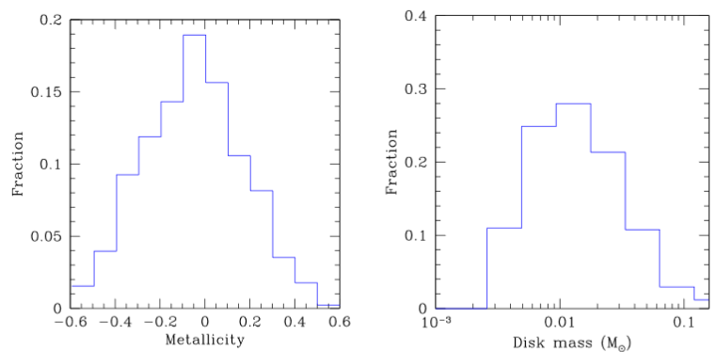
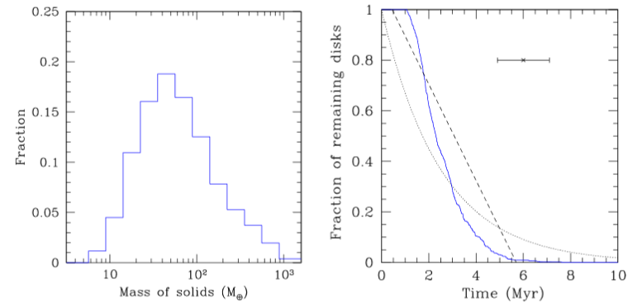
Initial distributions
Initial conditions for discs around 1 solar mass stars.
In addition, initial positions of embryos is also a random parameter.
1804.01532

Slide 7
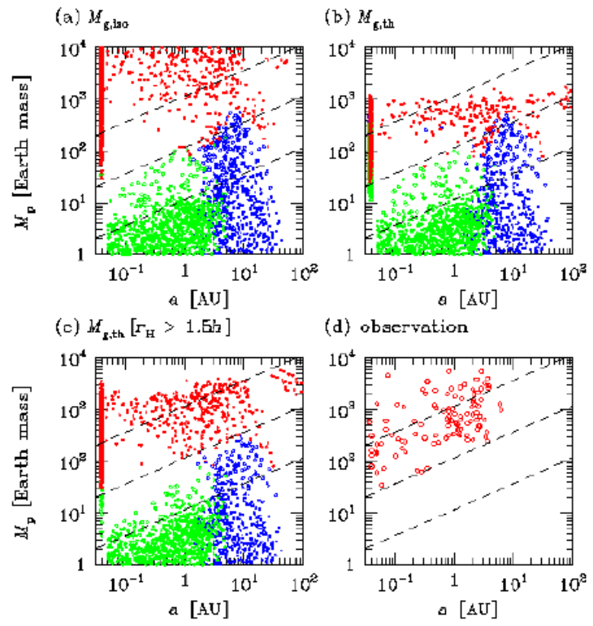
The first PS model for exoplanets
Authors modeled formation and migration (I&II) of exoplanets in order to reproduce so-called “desert” in mass-semi-major axis distribution (masses 10-100 Earth mass, and a<3 AU).
Main ingredients:
Disk model;
Accretion model;
Migration model.
The rate of type I migration was significantly reduced to avoid rapid planet displacement.
Red- giants; green – rocky; blue – ice.
Ida, Lin astro-ph/0312144

Slide 8
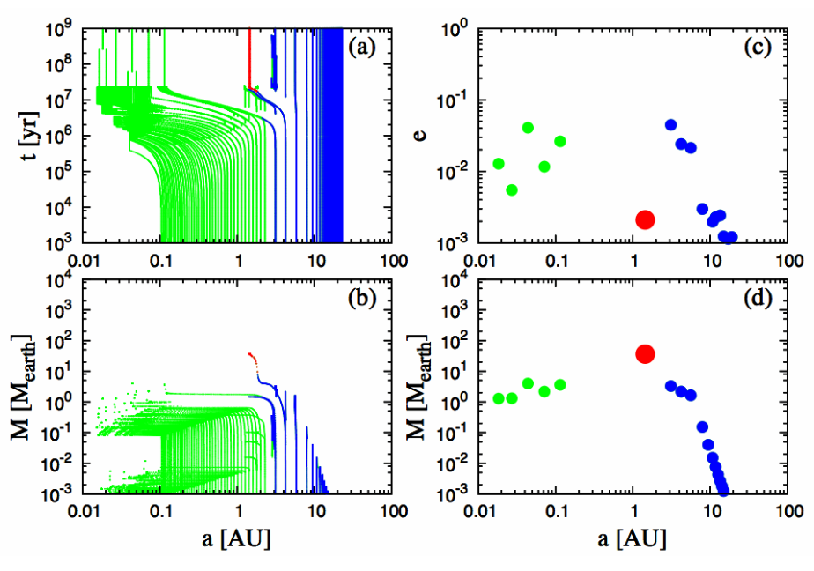
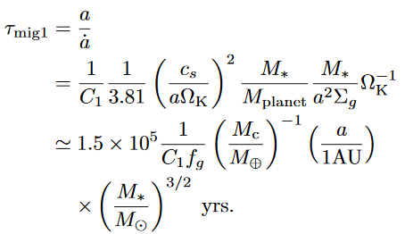
Individual tracks
Green - rock Red - gas Blue - ice
C₁ = 0.1; f_{d,0}=2
Ida, Lin 2013

Slide 9
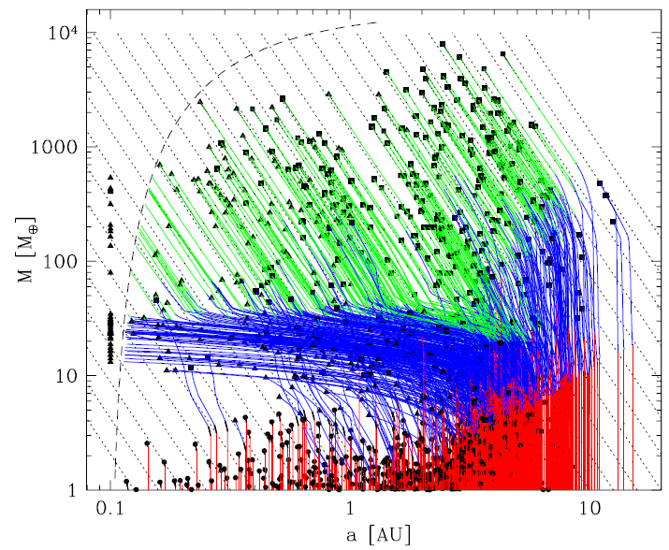
Mordasini et al. models
Mordanisi et al. published a series of papers (0904.2524, 0904.2542, 1101.0513, 1201.1036) on population synthesis of exoplanets, using an approach generally similar to the one by Ida, Lin. Then this studies were continued in
1206.6103, 1206.3303, 1708.00868. A review is given in 1402.7086. An important step is too include planet-planet interactions. A separate subject is to follow long-term evolution.
0904.2524

Slide 10
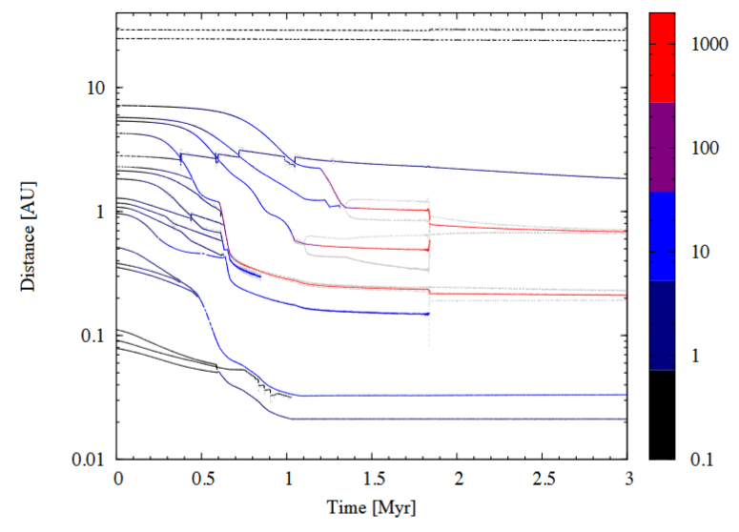
Multi-embryo system
20 planet embryos with M=0.1M_{Earth}
1804.01532

Slide 11
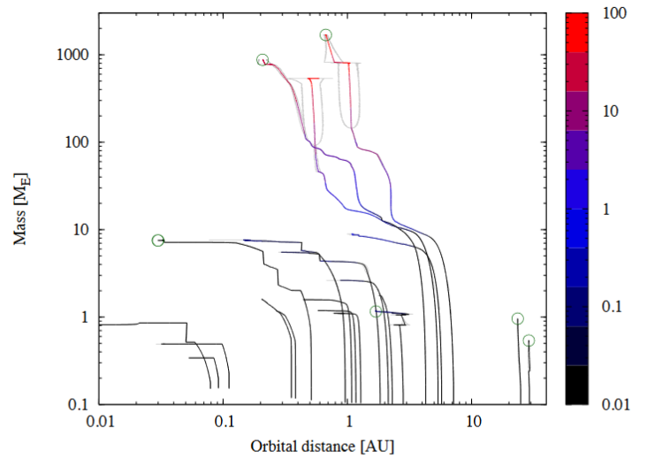
Mass growth
1804.01532

Slide 12
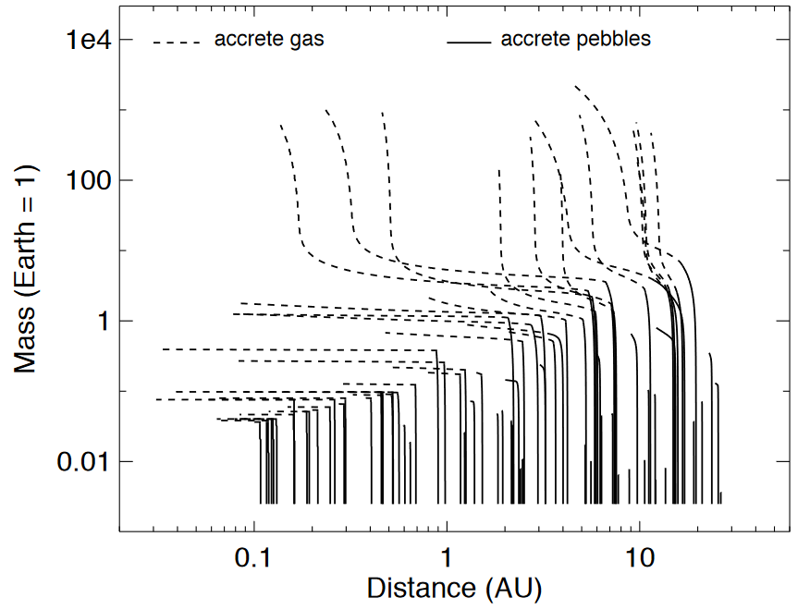
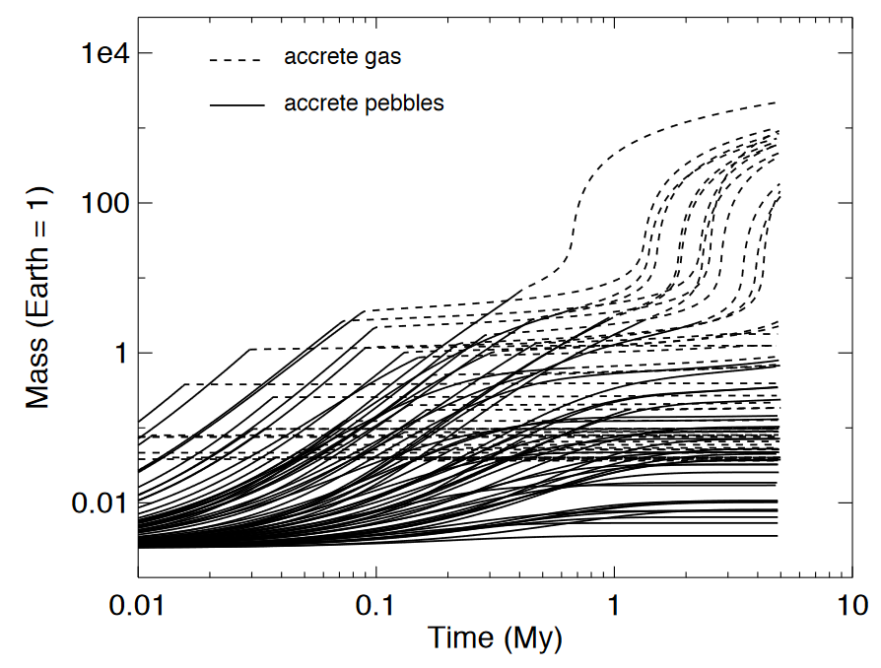
Peebles and gas accretion
1808.03293

Slide 13
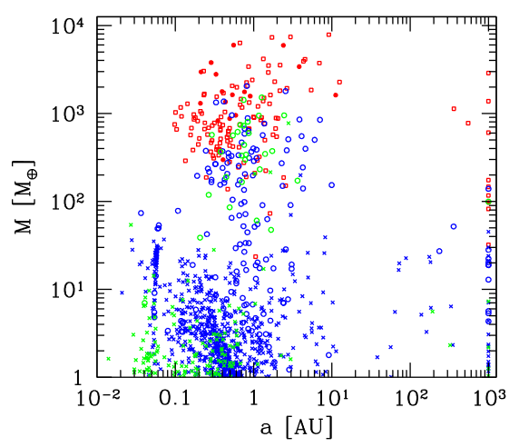
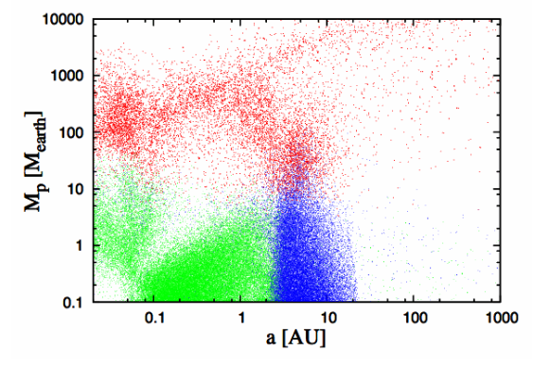
Mass – semi-major axis distribution
Alibert et al. (2013)
Ida, Lin (2013)
1402.7086

Slide 14
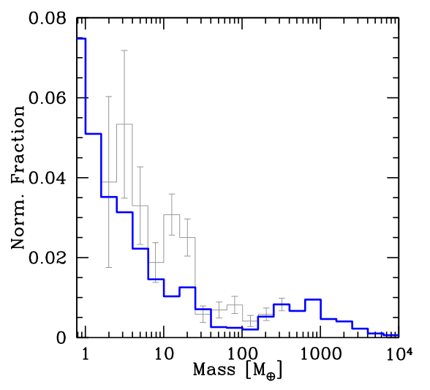
Mass distribution
Thick line – computations; Thin line – bias-corrected data. Normalization made for 1M_{Jup}
It is still not absolutely clear, if the so-called “planetary desert” exist or not.
1402.7086

Slide 15
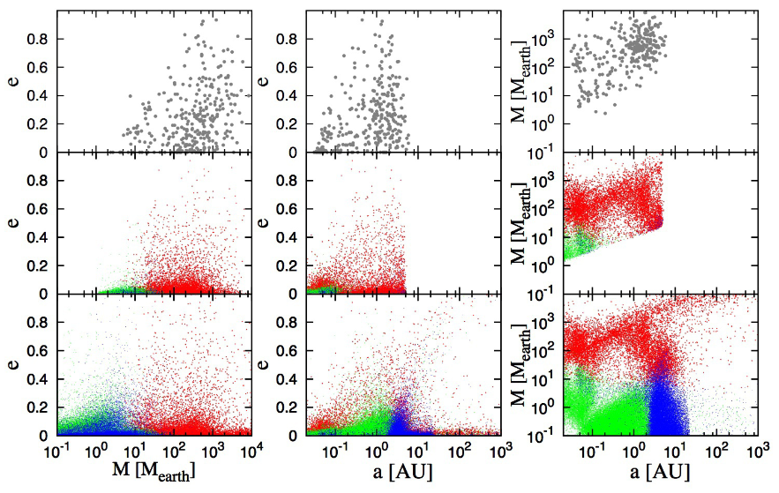
Comparison with observations
Observations
Calculations for observable planets (P_{orb}<10 yrs; v>1 m/s)
Calculations
Ida, Lin (2013)
1402.7086

Slide 16
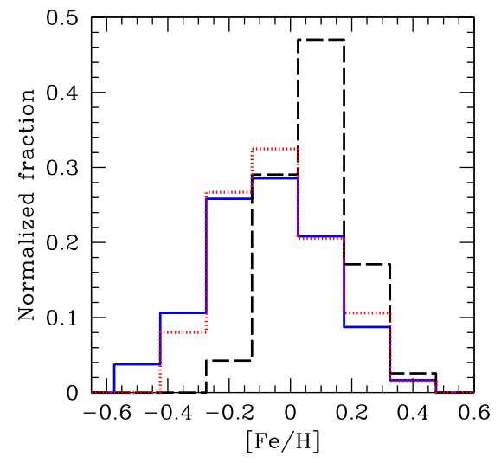
Metallicity effect
Solid line – all stars. Dashed line – stars with at least one giant planet. Dotted line – stars with at least low-mass planet.
1402.7086

Slide 17
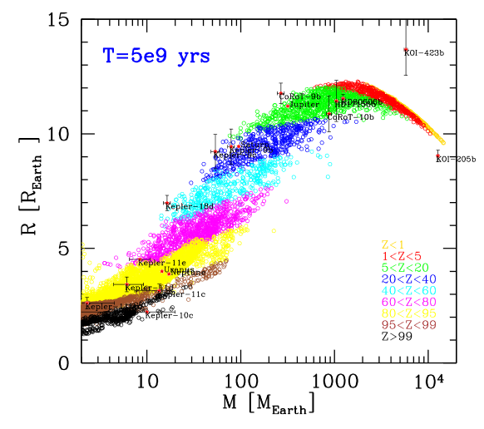
Composition
Formation and evolution model allows to estimate the bulk composition of planets.
1402.7086

Slide 18
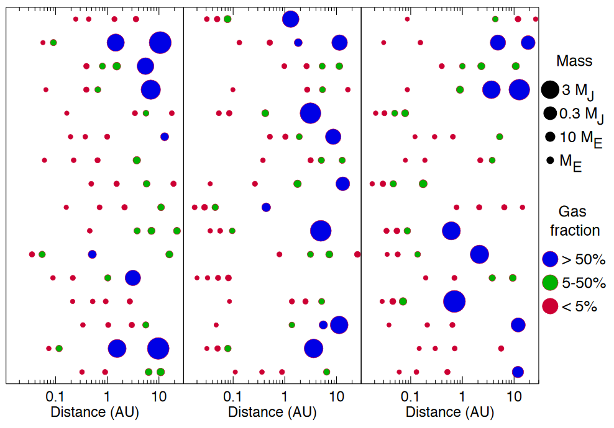
Another population synthesis model
Simple model with analytical equations. Model parameters are optimized to fit known data. Single and four planet cases were studied.
1808.03293

Slide 19
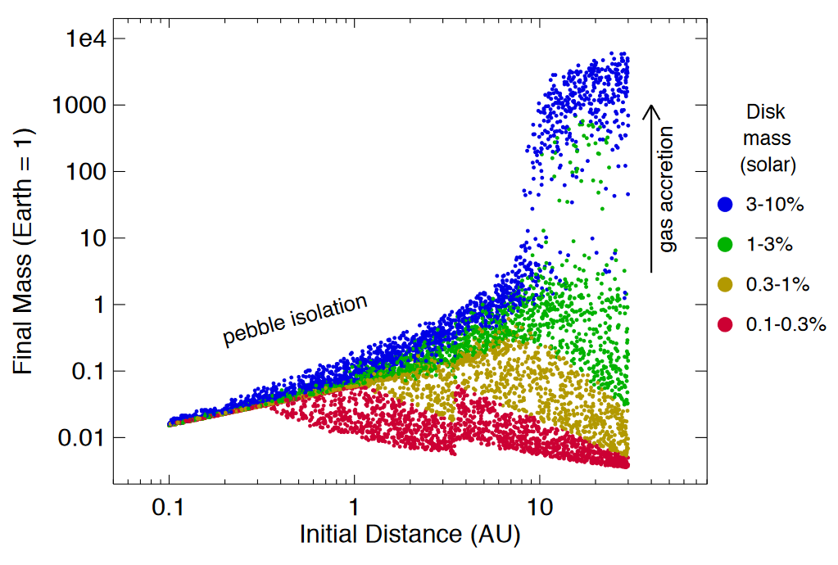
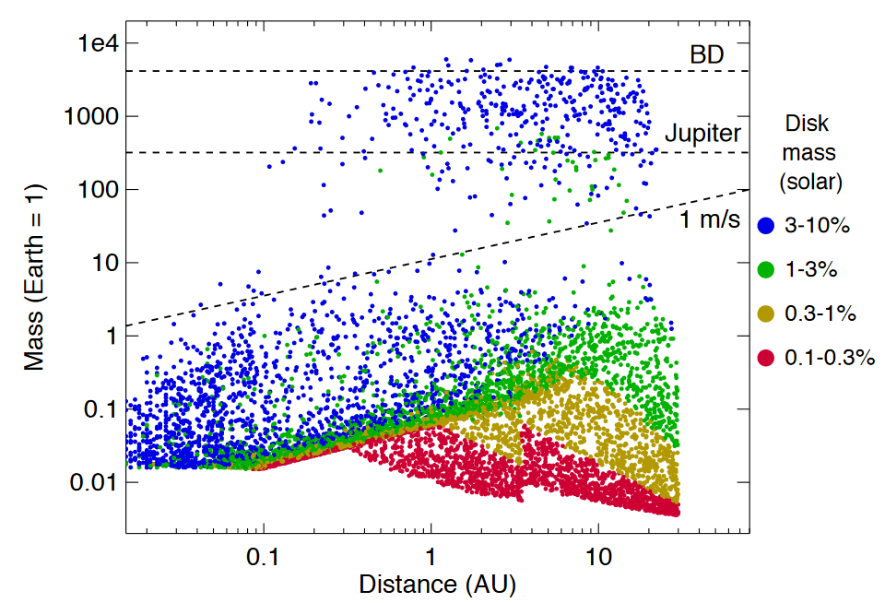
Mass- distance distribution
1808.03293

Slide 20
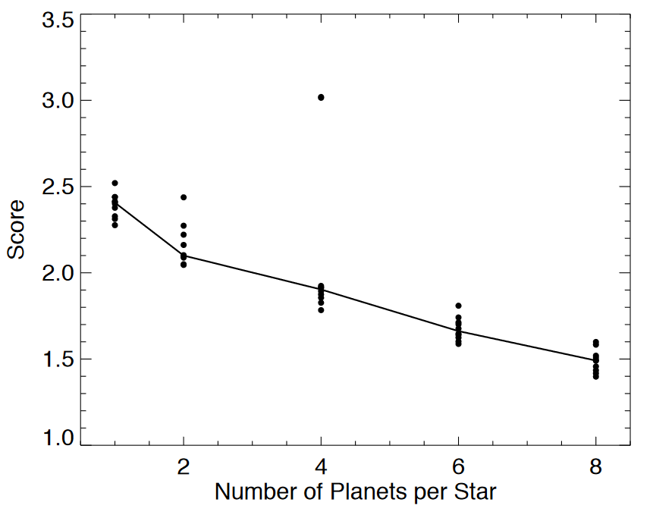
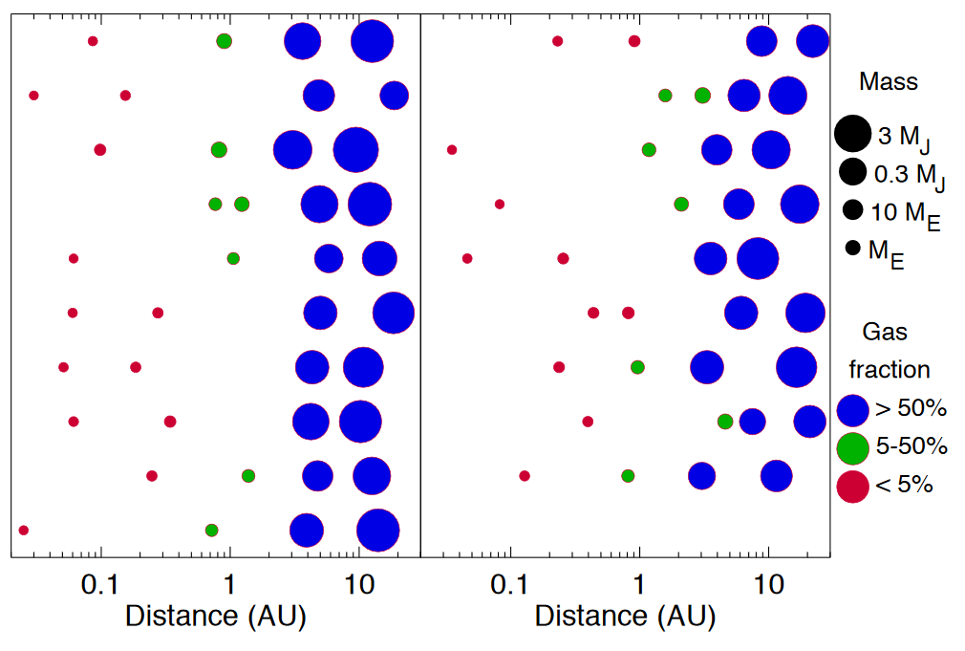
Number of planets and SoSys analogues
Shows how the fit improves with growing number of planets
1808.03293

Slide 21
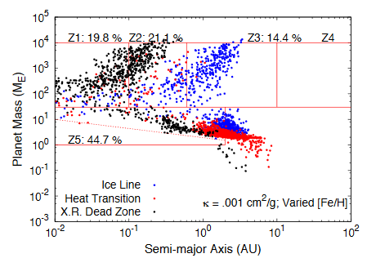
Role of more complicated migration models
Traps (regions of zero net torque) can slow planet migration (type I).
Traps can be related to peculiarities in density or/and temperature profiles. For example, an ice line can be such critical distance, at which planets are trapped.
Heat transition zone – is another trap. There viscous heating (inside) is changed by irradiation by the star (outer zone). X-rays due to magnetospheric accretion and cosmic rays ionize the disk. Low ionization produces dead zones in the disk.
1804.01148

Slide 22
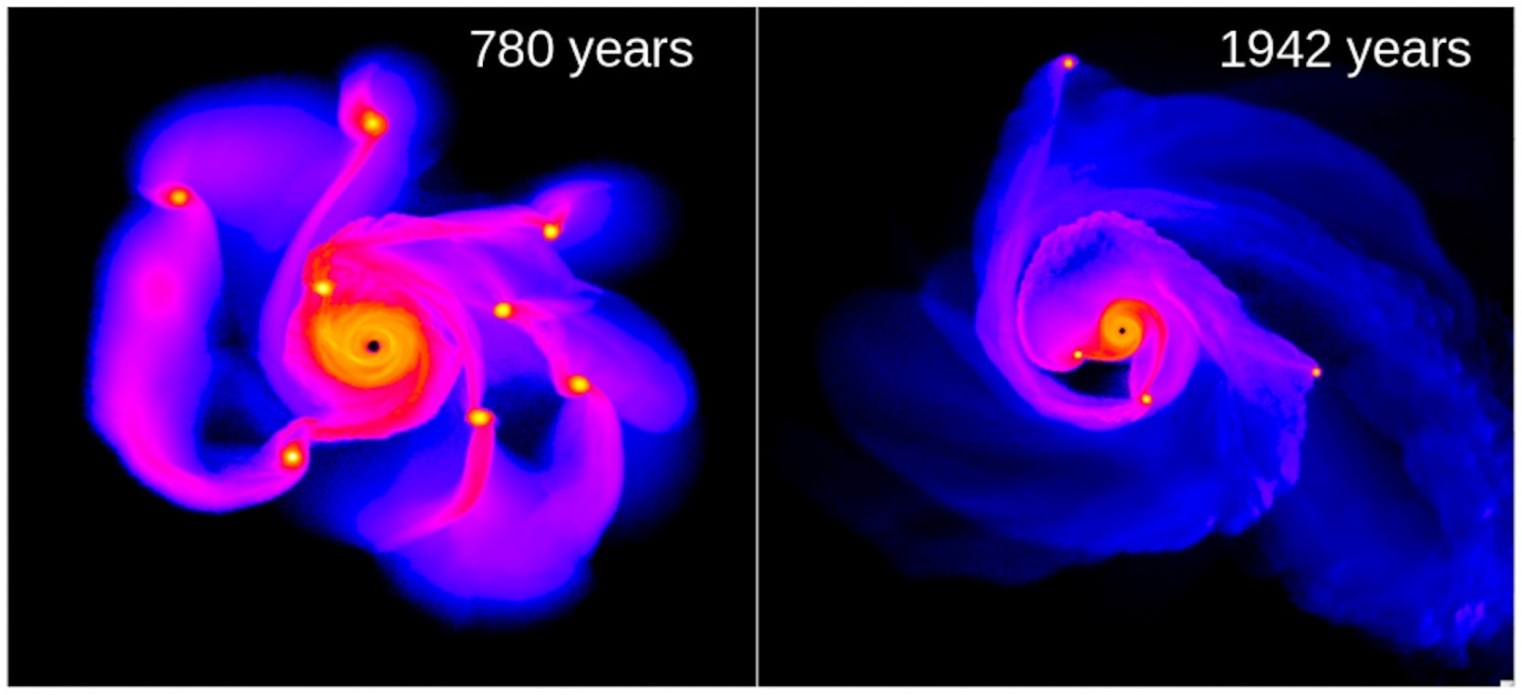
Another way to form planets
Gravitational instability in the outer parts of the disc. Allows to form massive planets out to few tens AU. Might also work for brown dwarfs and very light stars.
Lucio Mayer & T. Quinn
Some new results in 1711.05948

Slide 23
Tidal downsizing
Hypothesis by Nayakshin (2010). It is possible to make solid planets at low orbits
Fragment mass just after fragmentation
Hill radius becomes smaller as a planet migrates towards the star.
Evolution of a fragment in a disc can result in appearance of a low-mass planet closer to the star, or in appearance of a belt of particles.
1304.4978

Slide 24
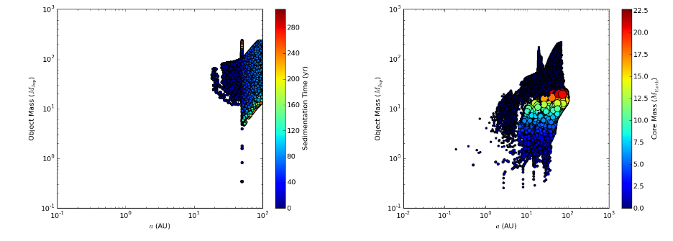
Initial and final semi-major axis distribution
Initial
Final, 1 Myr
45% survived 20% formed solid cores
1304.4978

Slide 25
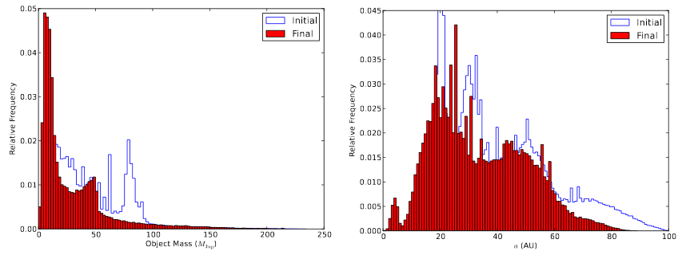
Mass and semi-major axis distribution
1304.4978

Slide 26
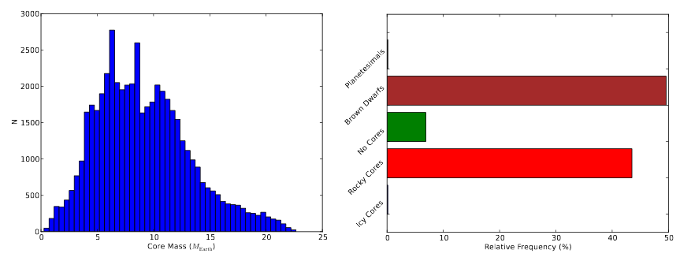
Mass distribution and planet types
Many brown dwarfs (and even low-mass stars for some parameters) can be produced via this channel.
1711.01133

Slide 27
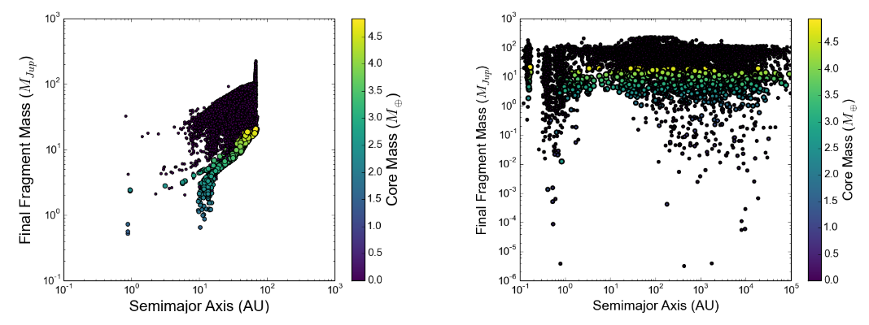
Role of fragment-fragment interaction
Interaction off
Interaction on
1711.01133

Slide 28
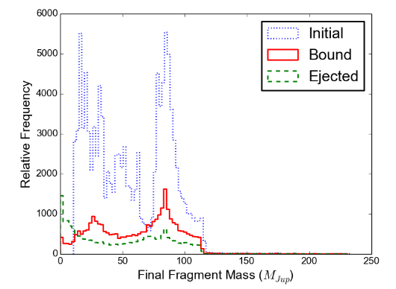
Ejection
Many fragments are ejected. So, this mechanism of planet formation can be an important contributor to the population of free-floating planets and brown dwarfs.
1711.01133

Slide 29
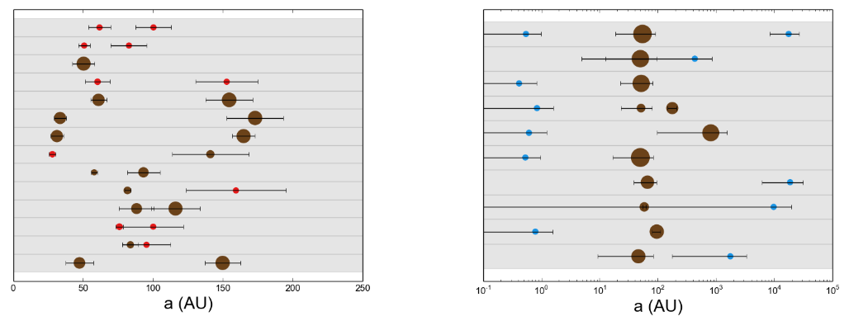
System architecture
Brown – brown dwarfs;
Red – gas giants; Blue – rocky (>50%).
Typical systems
Non-typical systems
1711.01133

Slide 30
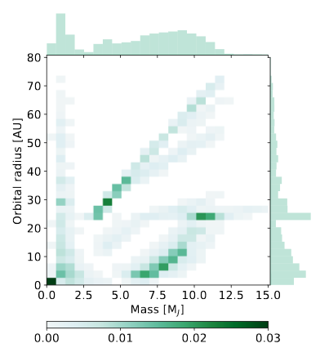
Another example of population synthesis of planets formed by instability
Many uncertainties. This picture summarizes all the models, calculated for different assumptions and parameters.
1801.03384

Slide 31
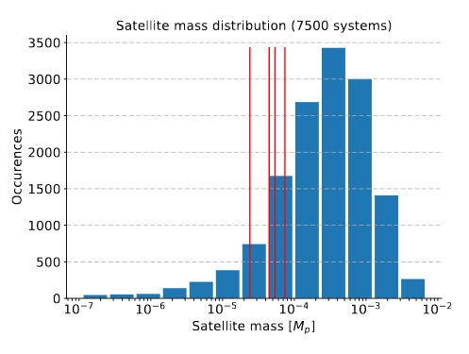
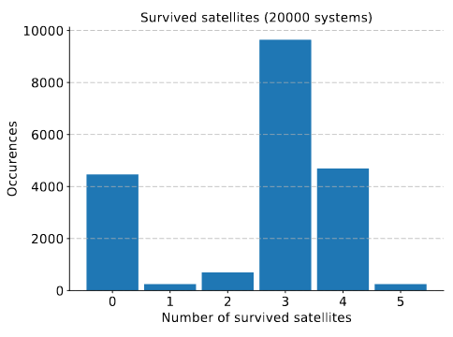
Population synthesis of satellites
1801.06094

Slide 32
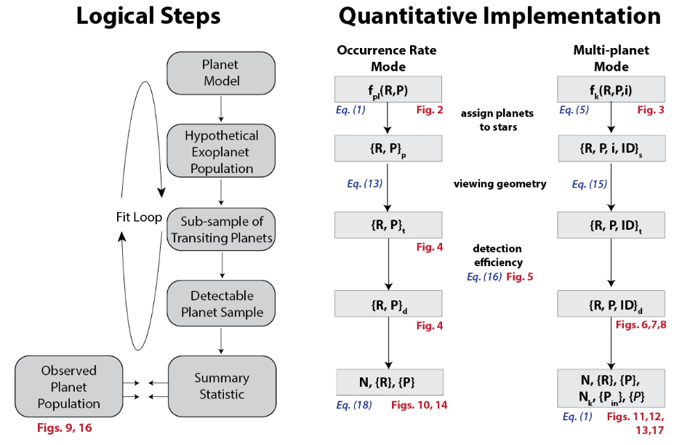
How to compare calculations with data
After calculations are made it is necessary to compare it with observational data. For the case of transiting planets a special script was written.
1805.08211

Slide 33
Literature
1402.7086 Planet Population Synthesis. W. Benz et al.
1804.01532 Planetary population synthesis. C. Mordasini

